Slide 1
Mississippi Office of Homeland Security
FY22 Homeland Security Non-Profit
Grant Implementation
Notes:
Good Morning and Welcome to our Grant Writing Session for the FY22 Homeland Security Grant Program. As with other years, this grant application is our main application for Homeland Security Non-Profit Grant funds and is part of our Statewide initiative.

Slide 2
Welcome and Introductions
MOHS Grants Staff:
Catrina Stamps-Non-Profit Programs
Rachel Day-Northern HSGP Programs
Kayla Stewart-Central/South HSGP Programs
Beth Loflin, Director of Grants and Finance
Notes:
Let’s Start with introductions of the MOHS Staff.

Slide 3
Orientation Topics
Information about the FY22 HSGP Grant
Let’s Talk Award Documents & Grant Requirements
SGA Manual-What is it?
Changes in Grant Reporting & How to Get the $$
Equipment Purchases and what is allowable?
Monitoring –
We are coming to see you soon!
Let’s Go Home
How do I Closeout the Grant?

Slide 4
FY22 Homeland Security Grant Program
Information about the FY22 Federal Non-Profit Security Grant Program

Slide 5
Homeland Security Non-Profit Grant Program
The Fiscal Year (FY) 2022 Homeland Security Non-Profit Grant Program (HSGP) is provided by Department of Homeland Security and the Federal Emergency Management Agency.
This grant is provided funding for physical and cybersecurity enhancements and other security-related activities to non-profit organizations that are at high risk for terrorist attacks.

Slide 6
Program National Priorities for Non-Profit Grant Programs:
Enhancing the Protection of Soft Targets/ Crowded Places

Slide 7
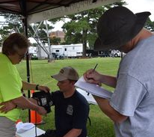
How do we make sure we meet the requirements of the National Program Priorities?
1) Effective planning
2) Training and awareness campaigns
3) Equipment and capital projects
4) Exercises
FY22 Program Priorities:

Slide 8
Federal Funding for FY22
For the Fiscal Year of the 2022 Homeland Security Grant, Mississippi Office of Homeland Security will award a total of:
FY22 Homeland Security Non-Profit Grant Program Grant Awards
$4,703,092.00

Slide 9
FY22 Homeland Security Non-Profit Grant Program
Let’s Talk Award Documents & Grant Requirements

Slide 10
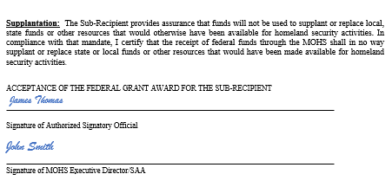
Award Letter
Notes:
1st in the Award Packet, you will receive an Award Letter. This should look very familiar with not a lot of changes. The information is pretty much the same with just a bit more space and a little easier to read.
When you get your documents, please review the information and make sure we have everything correct for your agency. The letter lists out the Sub-Recipient Name, Project Title, Grant Period, Total Amount of the Grant, Date of the Award and the Grant Number.
This information has been personalized for you. Your assigned grant number will need to be added to all your paperwork, as this is how we identify you in all of our tracking.
Grant Period: You grant period begins September 1, 2022 and ends August 31, 2023. This is a 1 YEAR GRANT and all work should be worked and equipment ordered and received within 1 YEAR. We do understand that there are currently issues with supplies and with ordering equipment, we will work with you on that, but we are trying to get the grants down to 1 YEAR.

Slide 11
Award Packet
The Grant Award Packet will need to be returned by
October 17, 2022, to the MOHS Email Address at:
mohsgrants@dps.ms.gov
Notes:
The Grant Award Packet is (1) one complete packet for your grant paperwork that will need to be returned to the MOHS. The deadline for the return of paperwork is October 17th, this should give you at least (2) board meetings to get the document before your Boards. If you can not meet the October 17th deadline, please let your Program Manager know in advance of the deadline.

Slide 12
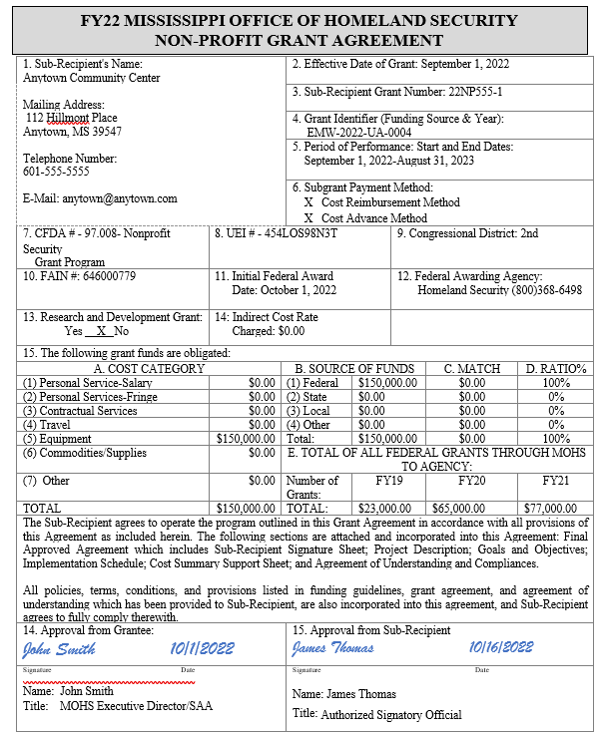
Signature Sheet
This sheet will be personalized for you with all the information already filled out for you, budgeted items in the cost categories.
Signature Required the Authorized Signatory Official.
Notes:
The Grant Award Packet is (1) one complete packet for your grant paperwork that will need to be returned to the MOHS.
You may be wondering why the award packet looks so different….. There are a few reasons #1, its now in compliance with all the federal guidance. The Signature page has added a few new elements, there is a cost category section, more data collected, the regulations have increased, etc.

Slide 13
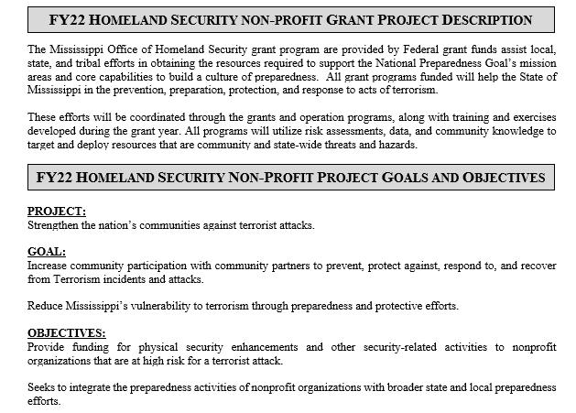
This is a new section added into the grant. Provides Sub-Recipient information on Grant Project Description and some Goals and Objectives of the Grant.
These are standard in every grant.

Slide 14
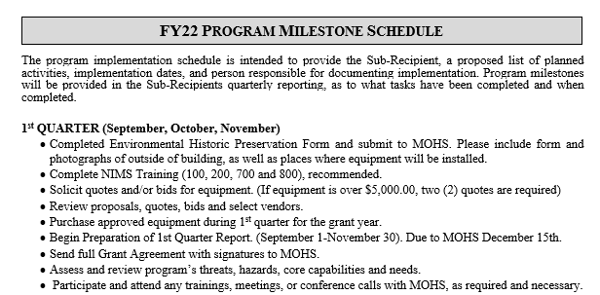
Program Milestones
This is also a new section in the Grant Award.
Notes:
If you have had a grant with us in the past, this was what was once called the Implementation Schedule. We would ask you what you would be doing with the grant for the upcoming year. This was very confusing as to what exactly what we were looking for and what exactly needed to be submitted.
This year we provided you with some help with filling this section out. You have a listing of potential activities that need to be done throughout the quarter. Examples are Submit the 1st Quarterly Report, Completed the NIMS Training, if you have not already, etc.
This information, you will see again with the Quarterly Reports.

Slide 15
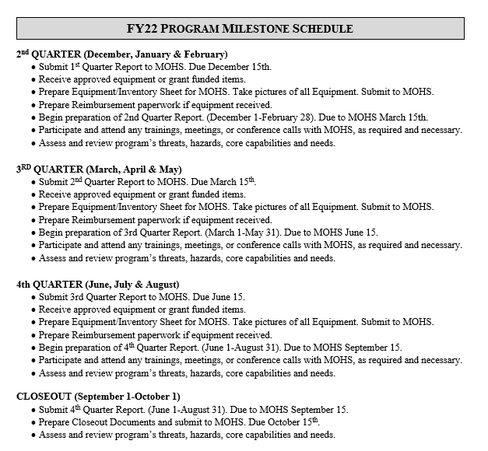
Program Milestones
This is also a new section in the Grant Award.
Notes:
You have a listing of all 4 quarters, along with a closeout section. This information should help you with the implementation of the program and keep you on track.

Slide 16
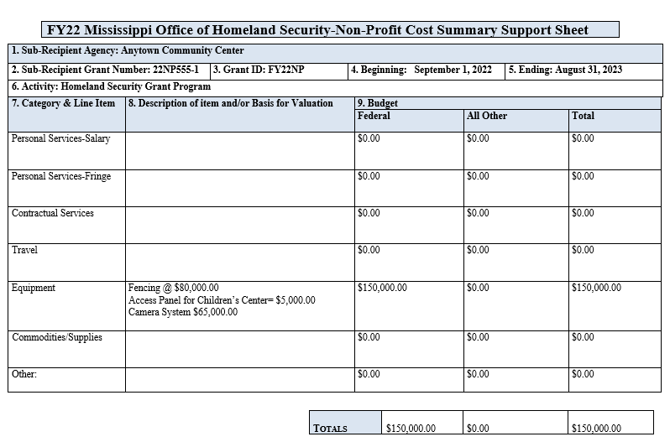
Budget Page
Notes:
Also updated for FY22 is the reduction of all the budget worksheets. We have taken the hard work out and the confusion out of the budget sheets. This is an all in one budget sheet that was been awarded from the Executive Committee.

Slide 17
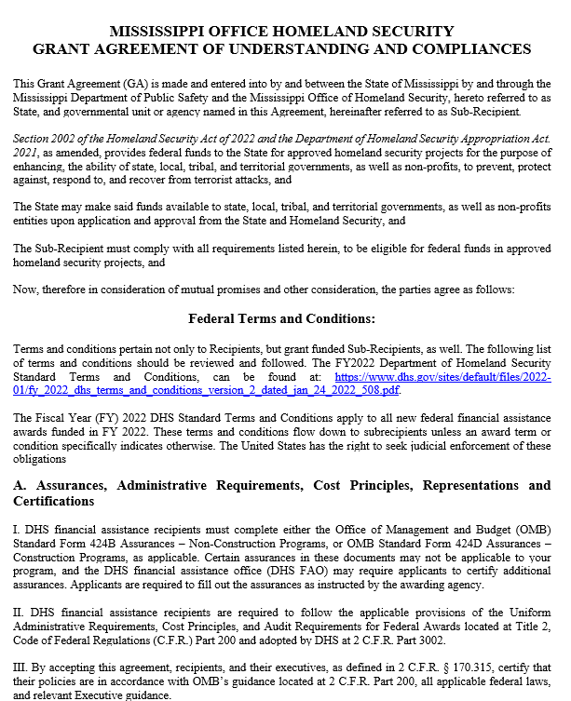
Federal Terms and Conditions
Notes:
When you get your grant packet, you will see a VERY expanded section for the Federal Terms and Conditions and then the MOHS Terms and Conditions. In previous award documents, we had not been including the most recent federal terms and conditions and have increased over time. Most of them are VERY common and well known such as Lobbying, Copyright, Civil Rights, Drug Free Workplace, etc. These are basic conditions that you have seen in most, if not all of your federal documents.
We do encourage you to read through the whole section to at least familiarize yourself with the terms.

Slide 18
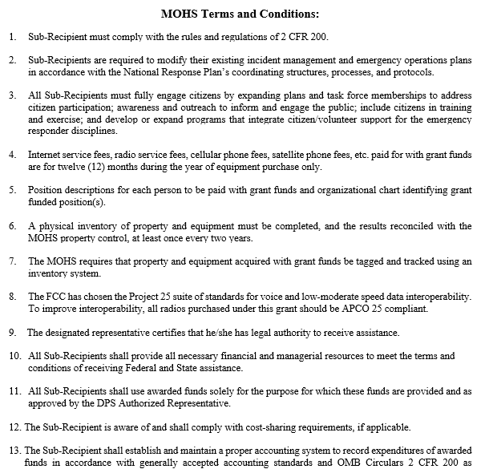
MOHS Terms and Conditions
Notes:
So as you can guess, we have also added into the MOHS Terms and Conditions. In past Awards, these terms were spread out in the Cooperative Agreement, Terms and Conditions, Special Conditions and the Grant Agreement documents. We have combined them into an all in one section and separated them out to make it a little easier to find what you need.
Please read through this section, as these terms and conditions must be complied with for the grant.

Slide 19
MOHS Terms and Conditions to Pay Attention to:

Slide 20
MOHS Terms and Conditions:
One of the Most Important Terms and Conditions is #1.
Sub-Recipient must comply with the rules and regulations
of 2CFR 200.
https://www.ecfr.gov/current/title-2/subtitle-A/chapter-II/part-200
Notes:
All agencies that provide grants to jurisdictions must follow the 2CFR 200 or commonly named the Super Circular. This is a VERY large document that helps govern the spending of federal funds and provided the do’s and don’ts in federal funds. We have tried to reference difference sections in the Supercircular to cross reference with the terms and conditions.

Slide 21
MOHS Terms and Conditions:
24. The Quarterly Reimbursement Claim and Progress Report: Request for reimbursement is due within 15 days after each reporting quarter:
Grant Period | Quarter | Date Report is Due
September 1-November 30 | 1st Quarter | December 15
December 1-February 28 | 2nd Quarter | March 15
March 1April 1-May 31 | 3rd Quarter | June 15
June 1-August 31 | 4th Quarter | September 15
Closeout | Closeout | October 15
Notes:
Number 24 of the Terms and Conditions sets out the change in the Grant Period and dates of reports that will be due. Please note…… Due dates are 15 days after the end of the Quarter.

Slide 22
MOHS Terms and Conditions:
29. Grant funds expended prior to the date of the award letter are not authorized to be reimbursed.
30. Each quarter the SGA will prepare and submit a Quarterly Request for Reimbursement to the MOHS. This request shall contain all appropriate supporting documentation to substantiate expenses made in accordance with all applicable requirements. The MOHS will review the reimbursement package for completeness and process for payment through the Mississippi accounting system, MAGIC.
31. The Recipient will not be liable under this Agreement for any amount greater than the award allocated by the FEMA and the Office for Domestic Preparedness to the State for the grant performance period.

Slide 23
MOHS Terms and Conditions:
Equipment:
40. All equipment awarded in this grant agreement must be ordered within ninety (90) days after project implementation. If unforeseen circumstances arise which prohibit this being accomplished, the MOHS must be notified as to the reason for the delay and projected purchase date of the equipment.
41. Property records must be maintained that include a description of the property, a serial number or other identification number, the source of the property, who holds the title, the acquisition date, cost of the property, percentage of Federal participation in the cost of the property, the location use and condition of the property and any ultimate disposition data including the data of disposal and sale price of the property.
42. A physical inventory of the property must be taken, and the results reconciled with the property records at least once every two (2) years for the useful life of the property.
43. A control system must be developed to ensure adequate safeguards to prevent loss, damage, or theft of the property. Any loss, damage or theft shall be investigated.

Slide 24
MOHS Terms and Conditions:
Non-performance of Grant Activities
49. Failure by the Sub-Recipient to comply with the terms of this Grant Agreement may result in suspension from the program and loss of any outstanding grant fund allocation balance, as determined by the Recipient.
50. Failure to expend all grant funds awarded (by date stated on Awards Letter) and to comply with Recipient request and guidelines will result in the reallocation of unspent grant funds and the immediate redistribution of all equipment purchased with grant funds.
51. In addition, the failure to maintain adequate response capability (as determined by the MOHS) will also result in the reallocation of grant funds and the immediate redistribution of all equipment purchased with grant funds.

Slide 25
MOHS Terms and Conditions:
Monitoring
54. Pursuant to Federal guidelines (2 CFR§200.328-329), the State has developed a plan for evaluating all projects. Each Sub-Recipient may be required, to have at least one (1) on-site monitoring visits during the grant year. All written documents will be reviewed to determine progress, problems, and reimbursements of the project. The State evaluates all sub recipient’s risk of noncompliance with Federal statutes, regulations and the terms and conditions of the sub-award for the purposes of determining the appropriate level of sub- recipient monitoring.
55. Management will evaluate audit findings, questioned costs and corrective action plans. The issuance of a written decision will be issued to the Sub-Recipient, which will entail whether or not the audit finding is sustained; the reasons for the decision; the expected action of the Sub-Recipient to repay any disallowed costs, make financial adjustments or take other actions; the reference number(s) the auditor assigned to each audit finding; and a description of any appeal process available to the Sub-Recipient regarding the management decision, as required by 2 CFR 200.521. If the Sub-Recipient has not completed corrective action, a timetable follow-up will be given.

Slide 26
MOHS Terms and Conditions:
Other Provisions
58. This agreement is not intended to conflict with current laws or regulations of Mississippi or your jurisdiction. If a term of this agreement is inconsistent with such authority, then that term shall be invalid, but the remaining terms and conditions of this agreement shall remain in full force and effect.
59. Sub-Recipient is required to ensure that grant monies are used to support all Emergency Service-related agencies and departments, specifically law enforcement, fire, and rescue. Senior officials of these agencies must sign this agreement and familiarize themselves with the rules and regulations governing each grant program. They are encouraged to work together in determining and prioritizing their needs and requirements prior to submitting their plan.

Slide 27
MOHS Terms and Conditions:
Other Provisions
60. All final requests for reimbursement, performance reports and closeout documents must be received in the Mississippi Office of Homeland Security within forty-five (45) days of completion of the project.
61. Any Sub-Recipient delinquent in submitting reimbursements, quarterly reports, and/or other required reports, or incomplete reports that lack sufficient detail of progress during the period in question, may be subject to having submitted reimbursement requests delayed, pending additional justification. Once completed reports are received, reimbursement requests will be processed.

Slide 28
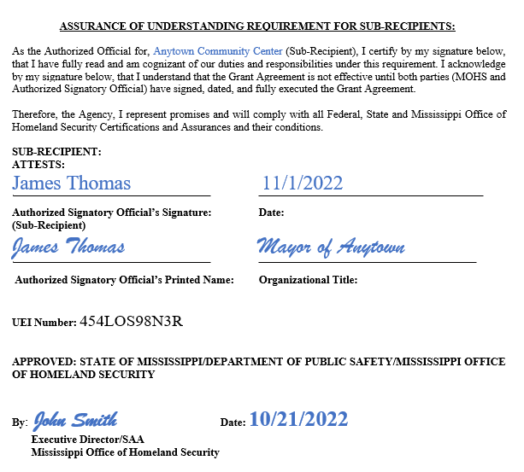
Assurance of Understanding Requirement for Sub-Recipients

Slide 29
MOHS Appendix Documents
Of the Grant Award

Slide 30
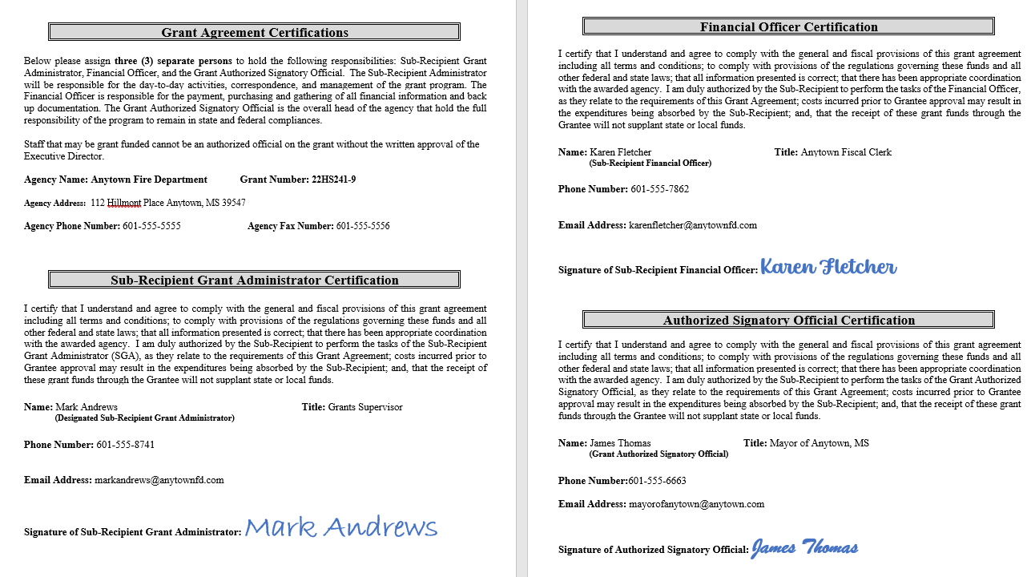
Notes:
This sheet has caused a lot of confusion and we hope this example will help. There should be (3) separate people to sign on this sheet.
1)Sub-Recipient Grant Administrator
2) Financial Officer
3) Authorized Signatory Official
Can not be the same people.
The MOHS provide grant details with anyone other than the designated people of the grant. These are the 3 main contacts of the grant.

Slide 31
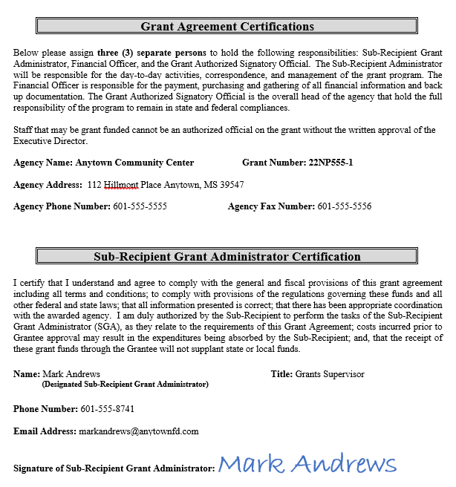
Designation of the Sub-Recipient Grant Administrator or SGA
Notes:
The Designation of the Sub-Recipient Grant Administrator (SGA) is the Authorized Signatory Official authorizing an individual to sign and manage the grant for the year. If this person changes during the year or you need more than (1) SGA, then please fill out an additional form.
This is the main contact person for the grant. The MOHS provide grant details with anyone other than the designated people of the grant.

Slide 32
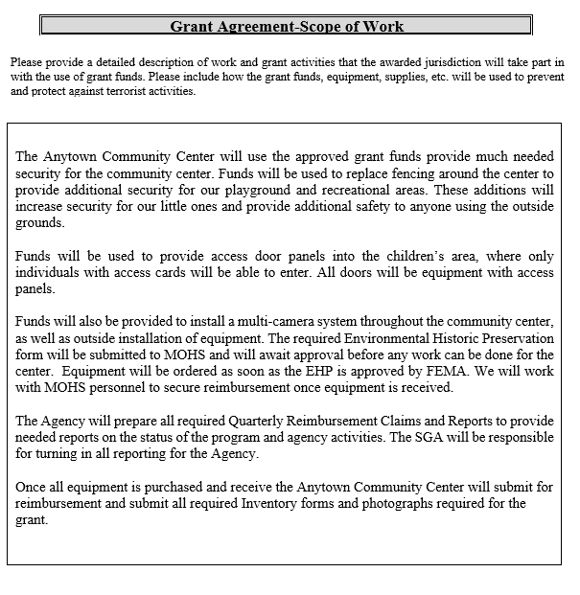
Scope of Work
Notes:
The scope of work should be a detailed description of that the Agency plans to do with the grant and the funding received. If you receive funds for training, please provide what the training is going to be on, who will attend training and what is the outcome of the training.
If you are purchasing equipment, how will this equipment hep support your community and help with the overall security of your area and the state.
Please include details on all the areas that were awarded funding and the plans of the agency.

Slide 33
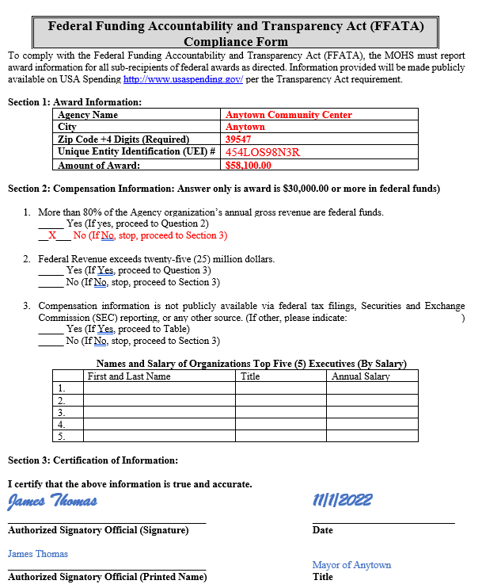
Federal Funding Accountability and Transparency Act (FFATA) Compliance Form

Slide 34
Get all Award Documents Signed and Return to:
mohsgrants@dps.ms.gov
By October 17, 2022
Need to Include all Award Documents with Appendix, and EHP (If Applicable)

Slide 35
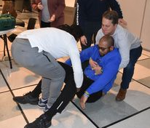
FY22 Homeland Security Grant Program
Setting up in MAGIC
Notes:
Before we get into purchasing and spending the funds, you must be set up in MAGIC. Most of you already are, but there may a few of the smaller agencies that may not have and need a little assistance.

Slide 36
All Sub-Recipients must be signed up and registered with the Mississippi Accountability System for Government Information and Collaboration (MAGIC).
All payments and reimbursement will come to you through this system. You MUST be registered in MAGIC or we will not be able to reimburse your agency.

Slide 37
Grant Reimbursement Request Process-MAGIC
All sub-recipients must register as a vendor in the Mississippi Accountability System for Government Information and Collaboration system (MAGIC).
Link to Vendor MAGIC Page: https://www.dfa.ms.gov/dfa-offices/mmrs/mississippi-suppliers-vendors/
Link to Vendor MAGIC Setup: https://sus.magic.ms.gov/sap/bc/webdynpro/sapsrm/wda_e_suco_sreg?sap-client=100#

Slide 38
Grant Reimbursement Request Process-MAGIC
Link to MAGIC Registration Form Instructions: https://www.dfa.ms.gov/media/1689/supplier-registration-form.pdf
Link to MAGIC Request for Change Form: https://www.dfa.ms.gov/media/1688/state-of-mississippi-supplier-form-extended.pdf

Slide 39
Grant Reimbursement Request Process-MAGIC
Please call the MMRS Call Center at (601) 359-1343, Option 2 for assistance in locating your vendor information.
MAGIC Help Desk: (601) 359-1346
MAGIC Registration Questions: (601) 576-1160

Slide 40
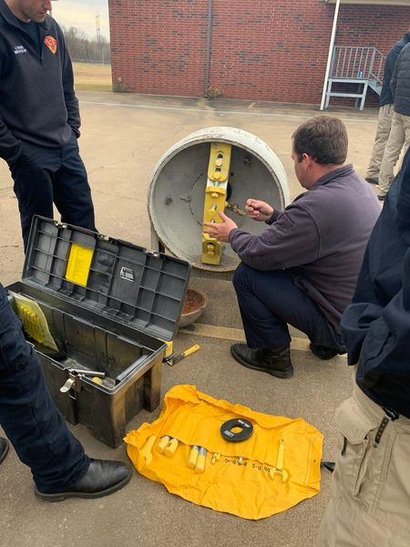
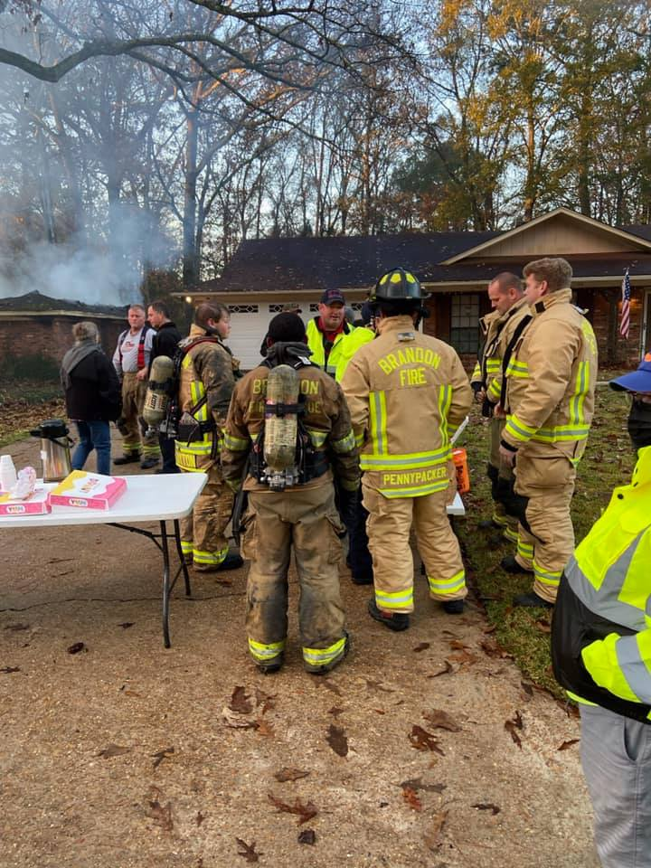
FY22 Homeland Security Grant Program
SGA Manual and What is it?

Slide 41
This guide will enable sub-recipients to manage an awarded homeland security grant and help guide in compliance with U.S. Department of Homeland Security, Federal Emergency Management Agency (FEMA) and State regulations.
This guide contains information and approved administrative and financial procedures and will assist staff and administrators in performing their assigned functions.

Slide 42
Sub-Recipient Grant Administrator’s Guide
Authority:
For a State to receive federal funds under Homeland Security Act, the Governor must establish a Homeland Security Agency that has adequate powers and is suitably and organized to carry out homeland security program to the satisfaction of the U.S. Department of Homeland Security (DHS) and the Federal Emergency Management Agency (FEMA). See Sections 2002 to 2004 of the Homeland Security Act of 2002 (Pub. L. No. 107-296), codified as amended (6 U.S.C. §§ 603-605) and the Department of Homeland Security Appropriations Act, 2021 (Pub. L. No. 116-260).

Slide 43
Sub-Recipient Grant Administrator’s Guide-Federal Rules We MUST Follow
Uniform Administrative Requirements, Cost Principals, Audit Requirements for Federal Awards (Super Circular): 2CFR Part 200 and 1201: The Super Circular super-cedes 49 CFR Parts 18 and 19 (Common Rule). The Super Circular was adopted by the Department of Homeland Security on December 26, 2014. All grants will follow the requirements in the Supercircular, 2 CFR Parts 200 and 1201.
Other Applicable Office of Management and Budget Circulars: Federal regulations at 2 CFR Parts 200 and 1201 supersede OMB Circulars A-21, A-50, A-87, A-89, A-102, A-110, A-122 and A-133. FEMA recipients are responsible for following all standards in 2 CFR Part 200 as modified by 2 CFR Part 1201.
Internal Management Controls: The MOHS shall have policies and procedures to reasonably ensure that: (a) programs achieve their intended results; (b) resources are consistent with agency mission; (c) programs and resources are protected from waste, fraud, and mismanagement; (d) Federal laws and regulations are followed; (e) reliable and timely information is obtained, maintained, reported and used for decision making; and (f) reasonable measures are taken to safeguard protected personally identifiable information and other information designated as sensitive, see 2 CFR Part 200.303.

Slide 44
Sub-Recipient Grant Administrator’s Guide-Federal Rules We MUST Follow
NIMS Compliance: The State of Mississippi formally adopted (Executive Order 932) and follows the principles of the National Incident Management System (NIMS) as specific by the U.S. Department of Homeland Security (DHS).
NIMS provides standards that ensure compatible equipment, training, and procedures for all Mississippi first responders.
All recipients and sub-recipients will ensure that purchased equipment conforms to NIMS and if said equipment is identified in the NIMS Resource Typing Definition that it conforms as defined by Federal Emergency Management Agency (FEMA).
Equipment, communications, and data systems acquired through State/Territorial and local acquisition programs are interoperable.
Subrecipients must be NIMS compliant and must sign a compliance with the Grant Application. Non-Compliance can result in funds being withheld or reallocated.
Training received will conform to the NIMS.
FEMA Incident Management Systems Division publishes a NIMS five-year training plan.
NIMS Information can be found at: http://www.fema.gov/emergency/nims/

Slide 45
Sub-Recipient Grant Administrator’s Guide-Planning
Step 1: Application Submission
(Sub-Recipient)
Step 2: Notification of Award (MOHS)
Step 5: Sub-Recipient starts grant activities and procures items. (Sub-Recipient)
Step 6: Reimburse Sub-Recipient. Sends in Reports and Documentation (MOHS)
Step 7: Sub-Recipient Closes out
(Sub-Recipient &MOHS)
Step 3: Draft Award Packet. Send to Sub-Recipient (MOHS)
Step 4: Implementation (MOHS)
Planning
Programming
Implementation
Monitoring or Review
Evaluation
Currently in Step 4

Slide 46
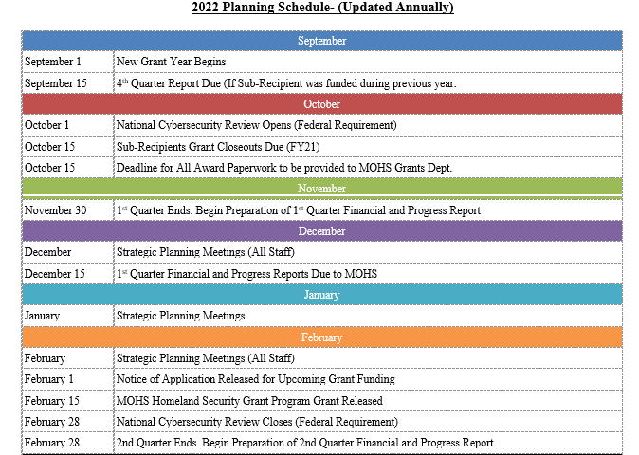
Sub-Recipient Grant Administrator’s Guide-Planning Schedule
Notes:
On Pages 5 & 6, you have the 2022 Planning Schedule. These are most, if not all the deadline dates and dates to turn in reporting. Post this somewhere, where you can see it. These dates are VERY important.

Slide 47
Sub-Recipient Grant Administrator’s Guide-SGA Responsibilities
The agency staff member responsible for the day-to-day oversight of a grant is the Sub-Recipient Grant Administrator (SGA).
The SGA is responsible for tasks associated with project management, correspondence, grant reimbursements and providing all documentation to support project.

Slide 48
Sub-Recipient Grant Administrator’s Guide-SGA Responsibilities
The SGA MUST read the Grants Agreement, Notice of Funding, and the Preparedness Manual for a working knowledge of the grant and the processes for the grant funding. All expenses incurred for the project must be within the specified period of performance of the grant award.
Costs incurred before September 1st or after August 31st of the fiscal year are not eligible for reimbursement.

Slide 49
Sub-Recipient Grant Administrator’s Guide-SGA Responsibilities
The SGA will expedite the Quarterly Financial Report, along with required documentation to be processed in accordance with the grant requirement without necessary delays.
The SGA will:
Establish and/or use an accounting system that conforms to generally accepted accounting principles and ensure that source documents are developed which will reliably account for the funds expended.
Establish the agency in the Mississippi Department of Finance, Mississippi Accountability System for Government Information and Collaboration (MAGIC). All reimbursements will be prepared and funded through the MAGIC accounting system.
Maintain copies of job descriptions and resumes of persons hired for all project-related positions which are grant funded. (if applicable)

Slide 50
Sub-Recipient Grant Administrator’s Guide-SGA Responsibilities
Maintain records showing actual hours utilized in project-related activity by all grant-funded personnel and by all other staff personnel or volunteers. (if applicable)
Any proposed changes in the project objectives, scope of work, key project personnel, time, budget or mailing address must be requested in writing and receive approval from MOHS.
Maintain records, files and equipment purchased for all activities for the MOHS
Submit a claim for reimbursement no later than the 15th day of the following month, after the quarter ends, in which expenses were incurred, using the form provided by MOHS as follows:
Copies of invoices and/or receipts for all specified items must be submitted upon request with the claim for reimbursement.
Claims must be submitted quarterly, even if activity did not occur.
Claims must be signed by the authorized signatory official or designated representative of the grant.

Slide 51
Sub-Recipient Grant Administrator’s Guide-SGA Responsibilities
The SGA will not:
Impose any task or permit any substitute activity not specifically provided for in the project agreement.
Approve expenses for activities that do not meet project performance specifications contained in the project agreement.
Authorize expenditure of funds except in accordance with the specific terms of the project agreement.
Offer advice that may adversely affect project performance, compromise MOHS’s rights, or provide the basis of a claim against MOHS that may affect any pending or future determination of fault or negligence.
Authorize or agree to any change in the project agreement, standard provisions, certifications, project period, delivery schedule, maximum amount eligible for reimbursement, or other terms and conditions of the project agreement, unless such change is specifically authorized in the project agreement; or
Promise or infer that a future agreement or extension of an agreement for another year is approved prior to MOHS approval.

Slide 52
Sub-Recipient Grant Administrator’s Guide-SGA Lifecycle of Grant
Step 1
Award Notification, Implementation, and Receive Award
Step 2
Get Award Signed and Return to MOHS
Step 3
Start Procurement and Purchase Equipment following Procurement Guidelines
Step 4
Fill out Quarterly Reimbursement/Progress Reports and Required Forms. Send to MOHS
Step 5
Take Part in Grant Monitoring and Grant Activities
Step 6
Closeout Grant
Notes:
The SGA has 6 Steps for the Grant.
Award Notification, Implementation and Receive Award- You are completing this step today.
Get the Award Signed and Return to MOHS by the Deadline
Purchase Equipment, Acquire Services, Purchase Supplies, etc. Make sure you follow all Procurement.
Fill out the Required Forms and send back to MOHS
Take Part in Grant Monitoring and Grant Activities through the year.
Closeout Grant
All these steps can reasonably be done within the (1) one year grant period of performance.

Slide 53
FY22 Homeland Security Grant Program
Environmental Historic Preservation Screening Form
Notes:
Before we get too involved with Reimbursement. We need to talk 1st about the EHP. This should be your 1st step after your Award

Slide 54
EHP Forms
FEMA is required by law to consider the effects of funding grant projects that may impact the environment or historic properties. This ensures all activities and programs funded by the agency comply with applicable federal EHP regulations, laws, Executive Orders, regulations and policies.
This is a FEDERAL Requirement.

Slide 55
EHP Forms
After you are awarded or during the award process, your Program Manager will send you a EHP Form.
Turn to Page 46 in your SGA Manual.

Slide 56
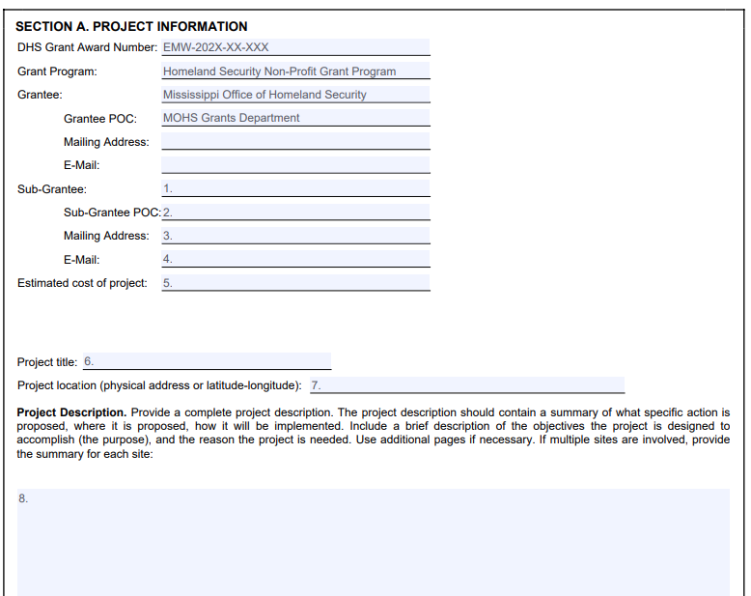
EHP Forms
You will include your contact information in the Sub-Grantee sections.
Add in estimate of Project Cost
Project Title and a Description of the Project. Use as much information as possible.
Notes:
You will include your contact information in the Sub-Grantee sections.
Add in estimate of Project Cost
Project Title and a Description of the Project. Use as much information as possible. If there is not enough information, FEMA will send it back and this will delay your approve. If you are getting a fence, describe what the fence will look like, the length of the fence, the materials of the fence.
If you are getting camera systems, be very specific on where the cameras are going to be located.

Slide 57
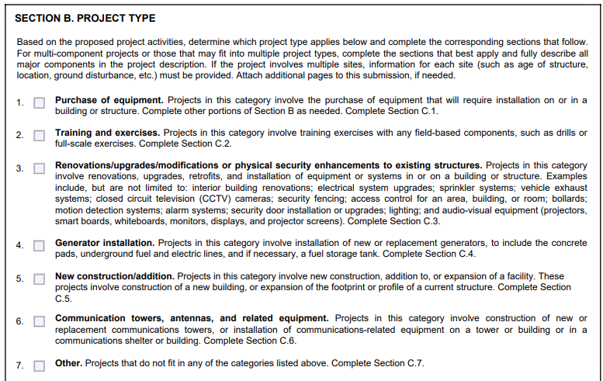
EHP Forms
Page 47 of the SGA Manual.
Mark which areas that your projects fall under. You can mark multiple areas.

Slide 58
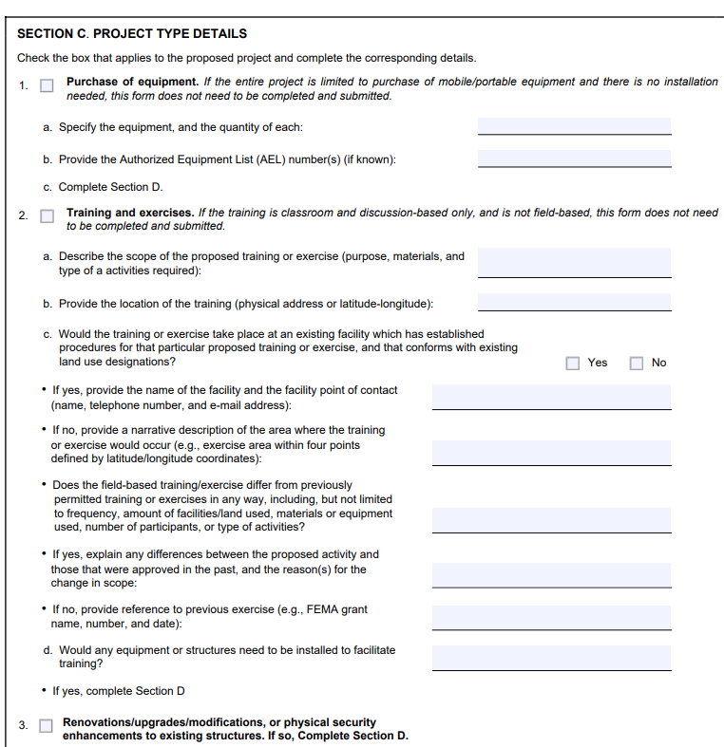
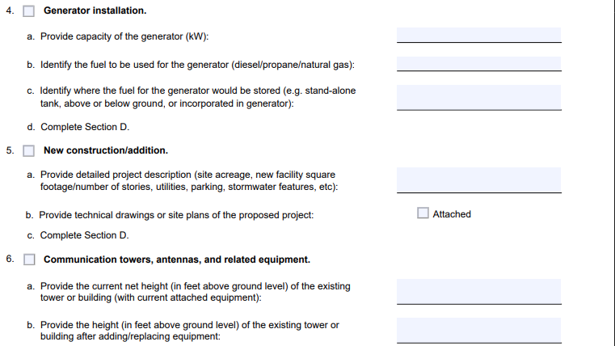
EHP Forms
On Section C. You will add in information that corresponds with the sections that you mark on the previous page.

Slide 59
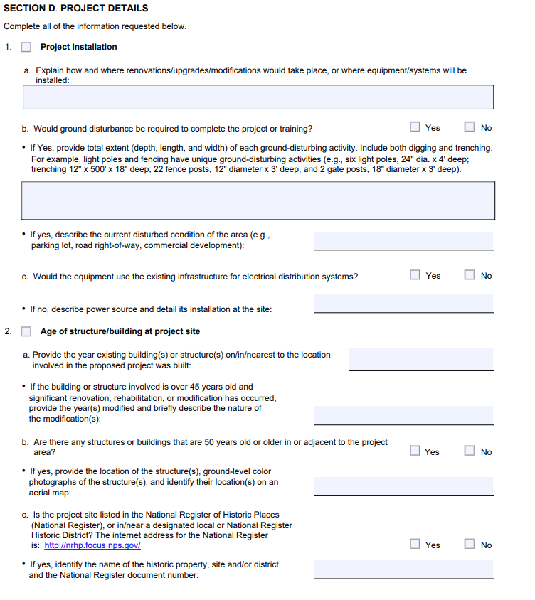
EHP Forms
On Section D. You will add in information that pertains to the installation and the age of the building or project site.
Add in detailed information.
If you have a structure that is near water, flood plain, archeological area, historic area, this will be very important to add in details.

Slide 60
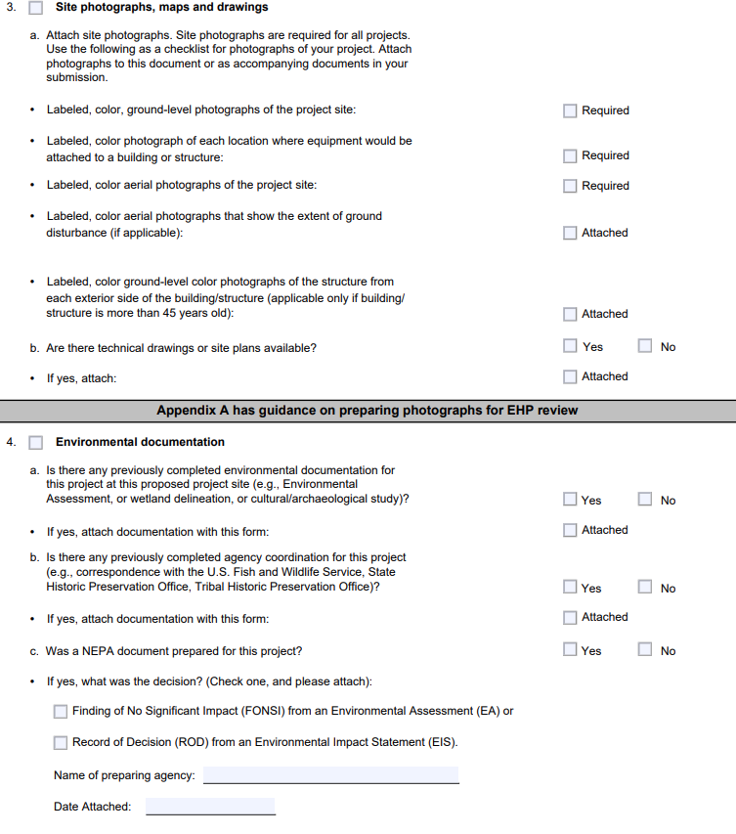
EHP Forms
On Section D. You will add in information that pertains to the installation and the age of the building or project site.
Add in detailed information.
If you have a structure that is near water, flood plain, archeological area, historic area, this will be very important to add in details.

Slide 61
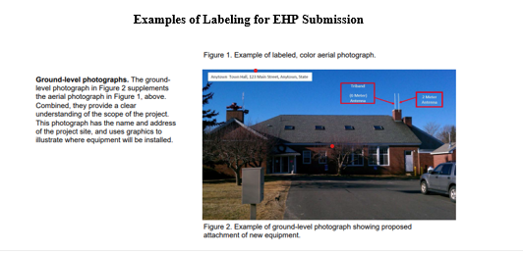
EHP Forms-Pictures for EHP
FEMA likes pictures of where everything will be installed. This is one of the biggest areas that they request additional information.
If you are getting fencing, they want an aerial view of where the fence will go. If you are getting an access panel, where is it going to be placed. Etc.

Slide 62
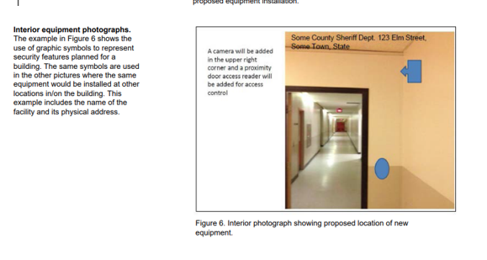
EHP Forms-Pictures for EHP

Slide 63
Submit EHP Form to MOHS
Get EHP Completed ASAP
After you completed the EHP form, you will submit to MOHS Grant Email: mohsgrants@dps.ms.gov
Program Manager will review.
Grants Director will submit to FEMA.

Slide 64
Submit EHP Form to MOHS
PLEASE BE PATIENT
FEMA review can take up to 6 months to approve and get through the process.
The process will take longer if there is ground disturbance, if you are in a historical area or near water.

Slide 65
Submit EHP Form to MOHS
ABSOLUTELY NO WORK CAN BEGIN, UNTIL THE EHP IS APPROVED!!!!!!
IF YOU BEGIN WORK BEFORE THE EHP IS APPROVED, WE WILL NOT BE ABLE TO REIMBURSE YOU.

Slide 66
After FEMA Approval
Once the EHP is Approved, you will be provided with an Approval Letter from FEMA.
You will be approved With Conditions or Without Conditions. Please read through the EHP approval letter.
Once Approval has been received you may start your projects.

Slide 67
FY22 Homeland Security Grant Program
Purchasing-What to do Before?????
Notes:
Now that you are set up in MAGIC and can receive funding from the State of Mississippi. By this time, you should have also sent back all the Award Paperwork back to MOHS and are not ready for STEP 3: PURCHASING. Before we get into the forms for reimbursement, you need to make sure what you are using the federal fund for is ALLOWABLE and you have the correct documentation for reimbursement.

Slide 68
Sub-Recipient Grant Administrator’s Guide- Purchasing
All purchases regardless of cost must meet all state purchasing laws and regulations and be in accordance to Section 7-7-23, Miss. Code Ann. (1972), state in part: “Purchases of equipment, supplies, materials or services of whatever kind of nature for a department, officer, institutions, or other agency of the state, the cost of which is to be paid from funds in the State Treasure on State Fiscal Officer disbursement warrants, may be made only by written purchase orders duly signed by the official authorized so to do, on forms prescribed by the State Fiscal Officer.
Purchases of such equipment, supplies, materials, or services, as specified herein, made without the issuance of such purchase orders shall not be deemed to be obligations of the state unless the State Fiscal Officer, by general rule or special order, permits certain purchases to be made without the same.”

Slide 69
Sub-Recipient Grant Administrator’s Guide- Purchasing
Required documentation:
Commodities & Non-Computer Equipment
0-$5,000 requires one quote.
Over $5,000 to $75,000 requires two quotes
Over $75,000 requires sealed bids (contract procurement)
Over $500,000 requires PPRB Approval
Contractual Services
0-$50,000 requires one quote.
Over $50,000 to $75,000 requires three quotes
Over $75,000 requires sealed bids (contract procurement)
Over $75,000 requires PPRB Approval
Computer Equipment
Require IT Director Approval
0-$5,000 requires one quote.
Over $5,000 to $50,000 requires two quotes
Over $50,000 requires sealed bids (contract procurement)
Over $50,000 requires ITS Approval
Over $500,000 requires PPRB Approval
Mississippi Procurement Rules
We MUST Follow all Rules for Procurement. MS Code 31-7-13
Notes:
This is YOUR RESPONSIBILITY. If you have not gone through the proper procurement, we CAN NOT REIMBURSE YOU.
Do not order, unless you have checked with your financial officer.

Slide 70
Changes in Grant Reporting
STEP 4: Grant Forms and Grant Requirements
Notes:
So now that the agency has purchased equipment, supplies or acquired a service, now you would like to be reimbursed.

Slide 71
Grant Advances
Advance Conditions: Advancement of of costs under a MOHS grant is contingent upon the following conditions:
The availability of appropriated funds
Actual costs having been are Quoted for the work (that is, services provided, hours worked, etc.) in accordance with the approved grant agreement and associated budget
Compliance with applicable cost principles referenced in the Grant Agreement.
EHP is submitted to FEMA and is in process. No work can start until approval.

Slide 72
Grant Advance Request Process: Before You Begin.
Must be permissible under MS and Federal law;
Must not be allowable to or included as a cost of any other federally funded program;
Must not result in a profit to the agency;
Must be incurred on or after the 1st day of the approved grant period; and
Must be adequately supported by source documentation.
MUST HAVE EHP Submitted to FEMA!!!!!!

Slide 73
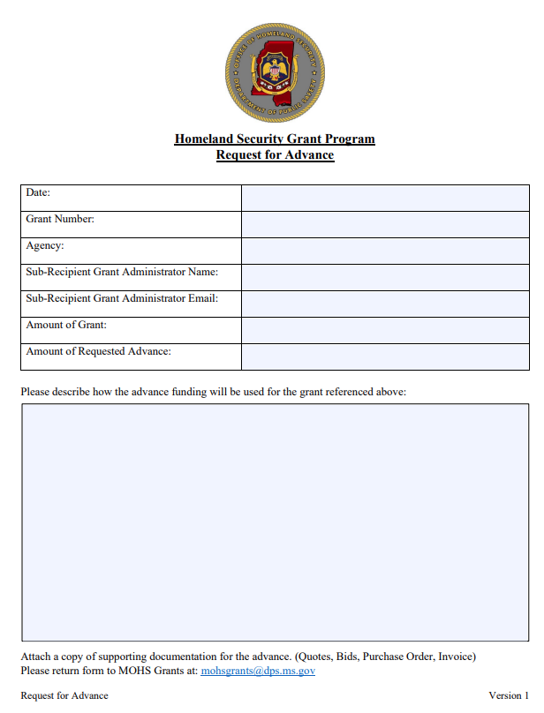
Grant Advance Request Process: Also include Quotes for Equipment/Services. Needs to be EXACT. Submit two (2) Quotes for any piece of equipment is $5,000 or more and/or state contract (DFA Rule)

Slide 74
Grant Advance Request Process:
Must be set up in MAGIC
Submit to mohsgrants@dps.ms.gov. Include Quotes and Advance Form.
After the advance has been issued to Agency. Agency is responsible for the payment documentation to clear advance. Ex. Proof of Payment, etc.
Additional advances will be denied, until previous advance is cleared with required documentation.

Slide 75
Grant Reimbursement Request Process: Submission of Requests
Reimbursement Conditions: Reimbursement of costs under a MOHS grant is contingent upon the following conditions:
The availability of appropriated funds
Actual costs having been incurred (that is, services provided, hours worked, etc.) in accordance with the approved grant agreement and associated budget
Compliance with applicable cost principles referenced in the Grant Agreement

Slide 76
Grant Reimbursement Request Process: Before You Begin.
Must be permissible under MS and Federal law;
Must not be allowable to or included as a cost of any other federally funded program;
Must not result in a profit to the agency;
Must be incurred on or after the 1st day of the approved grant period; and
Must be adequately supported by source documentation.
MUST HAVE AN APPROVED EHP!!!!!!

Slide 77
Grant Reimbursement Request Process
CHANGE IN GRANT REPORTING:
Sub-Recipient Program Manager Workbook:
Quarterly Reimbursement Claim and Progress Report
To simplify the grant reimbursement, claim and progress report process, the MOHS has combined all required submission forms into (1) one workbook to claim reimbursement and track progress. There are four (4) quarters that will be required for the FY22 grant year, along with a final closeout form.
Notes:
THIS IS AN ALL-IN-ONE APPROACH. ALL THE REQUIRED FORMS ARE IN ONE (1) WORKBOOK. NO MORE SEPARATE REIMBURSEMENT FORMS, QUARTERLY REPORTS AND THEN AN ADDITIONAL PERFORMANCE REPORT. THIS IS ALL IN ONE.
ALL WE ASK IS YOU SUBMIT EVERY QUARTER!!!!!!!!!

Slide 78
Grant Reimbursement Request Process
CHANGE IN GRANT REPORTING:
Grant Period | Quarter | Date Report is Due
September 1-November 30 | 1st Quarter | December 15th
December 1-Febraury 28 | 2nd Quarter | March 15th
March 1-May 31 | 3rd Quarter | June 15th
June 1-August 31 | 4th Quarter | September 15th
Closeout | Closeout | October 15
Notes:
This will take a little getting use to….. With the change to the Period of Performance from FEMA, so have the grant periods. Our Period of Performance begins….. September 1 and Ends August 31. ALL grants will follow this schedule, so if you have a grant from a previous year, we will follow this schedule to reduce confusion.
PLEASE NOTE…….. THE DUE DATE IS 15 DAYS AFTER THE END OF THE QUARTER.
EVEN IF YOU DO NOT HAVE REIMBURSEMENT THE 1ST QUARTER, YOU STILL NEED TO REPORT YOUR ACTIVITIES.

Slide 79
Grant Reimbursement Request Process
Each quarter, the Sub-Recipient should fill out the tab that is required for the quarter, prepare all information, provide required documentation, scan and submit to the MOHS Grant Address:
mohsgrants@dps.ms.gov.
Quarterly Forms are due no later than the 15th day of the following month.
Notes:
You will fill out the Quarter that you are in, print out, gather information, scan as (1) document and submit to MOHS email address.
Please send this to MOHS GRANTS Email. If you want to copy your Program Manager, that’s okay, but you have to send it to the MOHS EMAIL ADDRESS.
If you send it to just the Director, it may get by passed and not process. If you send it to just the PM, it may get bypassed and not processed. The MOHS email is tracked for ALL documents that are emailed in and we keep record of when documents are sent in.

Slide 80
Grant Reimbursement Request Process
Reimbursement can take a minimum of thirty (30) days for the reimbursement to be processed with our office and reimbursement to be received.
Our staff will process reimbursements, as they are received and as quickly as possible.

Slide 81
Grant Reimbursement Request Process
Reimbursement or to Clear an Advance
Submit Quarterly Reimbursement Claim and Progress Report form
Copy of the Paid Invoice(s)
Copy of the Purchase Order, Cancelled Check(s), expenditure report, or any other proof of payment
Submit “Equipment Inventory” form
Submit two (2) Quotes for any piece of equipment is $5,000 or more and/or state contract (DFA Rule)
Pictures of equipment displaying the serial/vin number

Slide 82
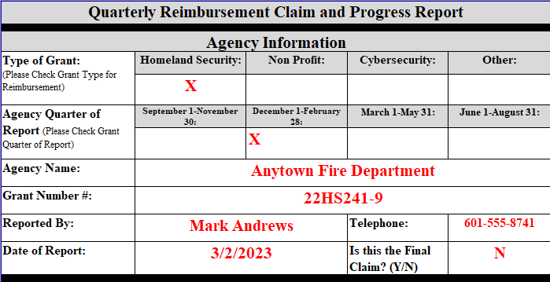
Grant Reimbursement Request Form
Turn to Page 27 in the SGA Manual

Slide 83
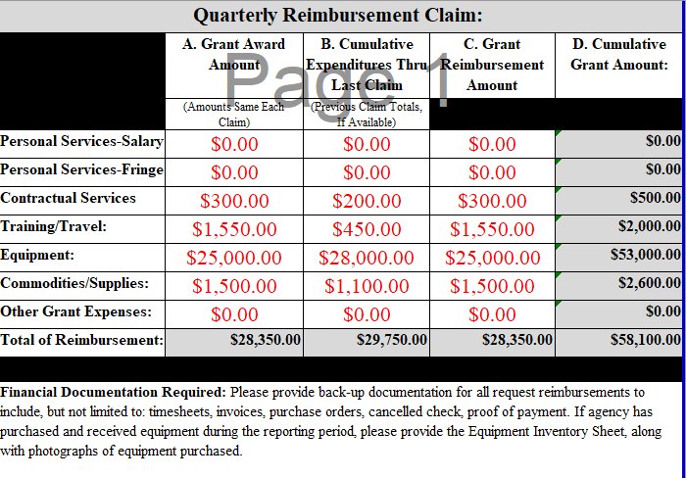
Grant Reimbursement Request Form
Turn to Page 28 in the SGA Manual

Slide 84
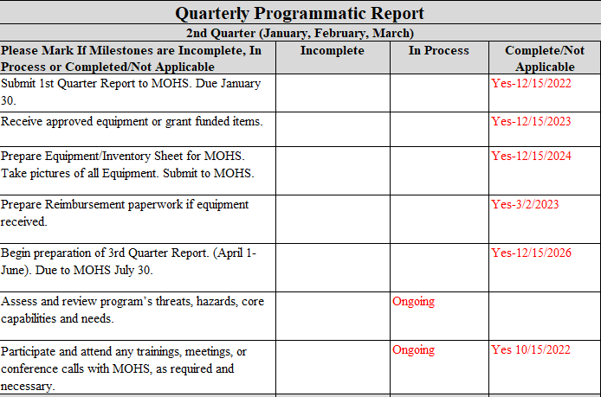
Grant Reimbursement Request Form
Turn to Page 29 in the SGA Manual
Notes:
Turn to Page 29. This is the beginning of the Quarterly Programmatic Reporting. Each Quarter has been customized for the quarter and should reflect where you “should” be with the grant. If you have a task that is not completed, there are spaces that can be added to additional tasks.

Slide 85
Grant Reimbursement Request Process
Please include information regarding any changes or modifications to the original objective of the grant. Please do not leave blank.
Notes:
In this example there were no changes or modification. If you anticipate any changes or modifications such as delays in shipping, need to change the scope of the project, etc.

Slide 86
Grant Reimbursement Request Process
Please include any information regarding any changes to authorized persons on the grant. Please do not leave blank.

Slide 87
Grant Reimbursement Request Process
Please list out any training or exercises that the Agency participated in during the quarter. Please do not leave blank.
Notes:
There are a lot of training opportunities and exercises available to take part in. If you do not have any, write in some training that you may want in the future and we can see if we can work in getting you and your staff into training.

Slide 88
Grant Reimbursement Request Process
Please list out any challenges or delays that the agency may have encountered related to grant activities during the grant period. Please do not leave blank.
Notes:
This section is really important for us to know if your agency is having any challenges with the grant or that may cause delays.
Be mindful….. Do not put down supply chain issues, if you have not started the procurement process. Do not put down reimbursement issues, if you have NOT provided the correct paperwork or event send in the correct award packet information.

Slide 89
Grant Reimbursement Request Process
Please include and successes that your agency has experienced during the current or previous reporting period. Please do not leave blank.
Notes:
Now, this is a new section and we are looking for agencies to include successes from your agency. We want to help celebrate your successes, not our. If your agency has participated in training or exercises or used the equipment that was purchased with the federal funds. If you have seen positive results in your area, please let us know.

Slide 90
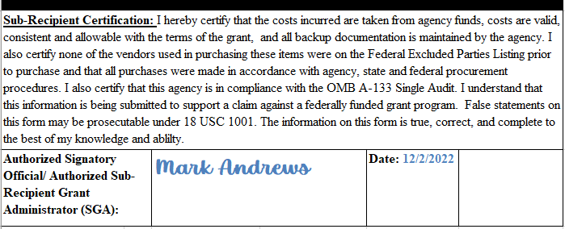
Grant Reimbursement Request Process
Please review all information provided for the report. Once all information is validated and back-up documentation attached, please have the Authorized Signatory Official (Mayor/Board President or Commissioner)

Slide 91
Grant Reimbursement Request Process: Submission of Requests
Submission of all reports and supporting documentation should be emailed to:
mohsgrants@dps.ms.gov.
Any sub-recipient delinquent in submitting reports, or incomplete reports that lack sufficient detail of progress during the period in question, will be subject to having submitted reimbursement requests delayed.
Once completed reports are received, reimbursement requests will be processed.

Slide 92
Let’s Take a Break
10 Minutes

Slide 93
Budget/ Reimbursement (Only if Approved)

Slide 94
Grant Reimbursement Request Process: Budget
Maximum Amount Eligible for Reimbursement: MOHS policy requires all agreements include a ‘maximum amount eligible for reimbursement. This maximum amount is the grant reimbursable amount and is MOHS’s share of the estimated project cost. The budget specifies each line item and cannot exceed the specified line-item amount for reimbursement. A line item in the budget is the authorization for funds to be expended on the item.
Increased Costs: If costs exceed the awarded amount in the contract, reimbursement will not be authorized. The MOHS will send a letter

Slide 95
Personal Service (Salary and Fringe) (Only if Approved)

Slide 96
Grant Reimbursement Request Process: Personnel (Salary/Fringe)
Personal Services (if applicable): Salaries & Wages--The agreed amount to be paid by federal share and amount to be paid as state or local match. The personnel section lists each position by title, showing the yearly salary and the percentage of time to be utilized for the project. All time reported to conduct program activities must be specifically for the funded project and must be program activities only for reimbursement of salary. Documentation must be provided for any amount claimed.
Proof of Payment: Proof of Payment can include Time Sheets, Monthly Time Activity Reports, payroll registry, account ledger, copy of payroll checks/cancelled checks, bank statement, direct deposit statement.

Slide 97
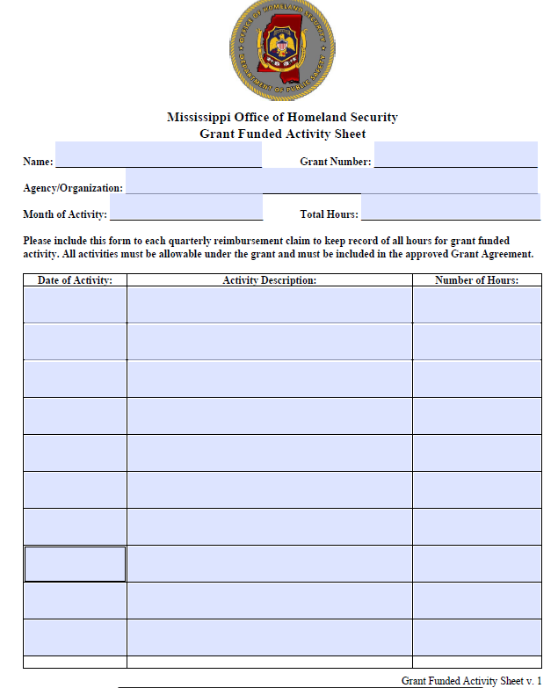
Grant Reimbursement Request Process: Personnel (Salary/Fringe)
Please add all contact information for the Agency/Organization.
Add in the Month of Activity and the Total Hours.

Slide 98
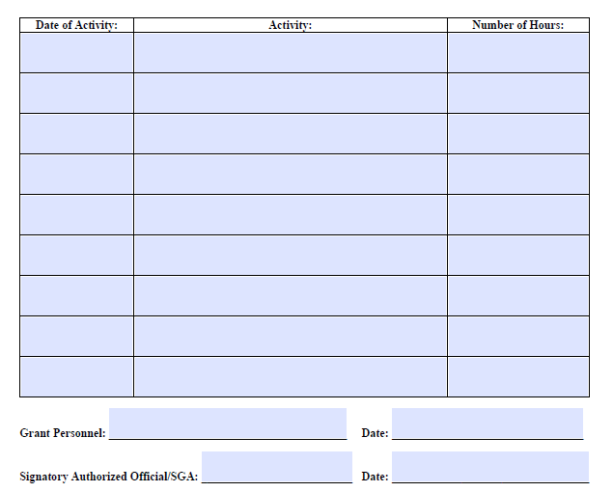
Grant Reimbursement Request Process: Personnel (Salary/Fringe)
Please sign the Grant Personnel and Signatory Authorized Official

Slide 99
Contractual Services (Only if Approved)

Slide 100
Grant Reimbursement Request Process: Contractual Services (1 Year Only)
Contractual Services:
Communication & Freight--The actual cost of communication expenses, such as telephone service, internet service, postage expense, and freight expense for shipping equipment will be reimbursed, if applicable. A copy of the cost allocation must be submitted to the MOHS. Documentation must be provided for any amount claimed.
Printing – The actual cost of printing will be reimbursed, if applicable. Documentation must be provided for any amount claimed.
Fees, Professional & Other -- The actual cost of outside contractual services, if applicable. Any consultant contracts must follow the bid procedures required by the state, or local ordinance if more restrictive, and must follow federal guidelines. The duties and qualifications of the consultant should be detailed in a narrative along with itemized budget detail outlining cost for service and included with the subcontract agreement. Agreements and sub-contracts must have prior approval from MOHS. See Project Agreement/Contract Development above.
Installation cost – associated with equipment installation such as radio, camera, etc. Documentation must be provided for any amount claimed.
Notes:
If you have contractual services listed in your grant award, please refer to Page 19 of the Grant Award. Contractual Services are only good for (1) year with the grant award. Copies of all contracts must be provided to the MOHS for addition to the files and all contractual services must go through correct Procurement practices.

Slide 101
Travel/Training (Only if Approved)

Slide 102
Grant Reimbursement Request Process: Travel/Training
Grant Activity Training: The MOHS will not reimburse for the training, unless approved in the MOHS agreement. Any training or training assistance that is claimed and not listed in the approved MOHS agreement will not be reimbursed. Additional information may be requested.
Travel: Section 25-3-41, Mississippi Code of 1972, establishes guidelines for travel reimbursement of officers and employees of the State of Mississippi, and of any department, institution, board, or commission thereof. The MOHS follows guidelines from the Department of Finance and Administration, Department of Public Safety and in house guidelines for all travel. Documentation must be provided for any amount claimed.
The agreed amount to be paid by federal share of expected expenditures and balance is to be paid as state or local match. Travel section must include estimated cost associated with each travel identified and must include all cost associated with the travel. Travel cost must be specific to program area and needed to carry out project activities.
Travel cost must coincide with all MOHS, state, and federal guidelines/policies/rates.

Slide 103
Grant Reimbursement Request Process: Travel/Training
Travel Voucher: All expenses to be reimbursed must be reported on an approved MOHS travel voucher for reimbursement. A copy of the travel voucher can be found: https://www.dfa.ms.gov/dfa-offices/purchasing-travel-and-fleet-management/bureau-of-purchasing-and-contracting/travel/
Travel Vouchers should be typed or completed in ink and signed by the employee. The signature is a certification by the traveler that reimbursement is being requested for actual expenses that are valid allowable business expenses.
One state employee should not claim expenses for another state employee.
Hotel/motel receipts must be itemized to be reimbursed.
Express check-out receipts which do not provide an itemized hotel bill are not acceptable.
The hotel bill submitted shall be the original form the hotel provides when the bill is paid.
Necessary travel expenses do not include personal expense items such as entertainment and trip insurance.

Slide 104
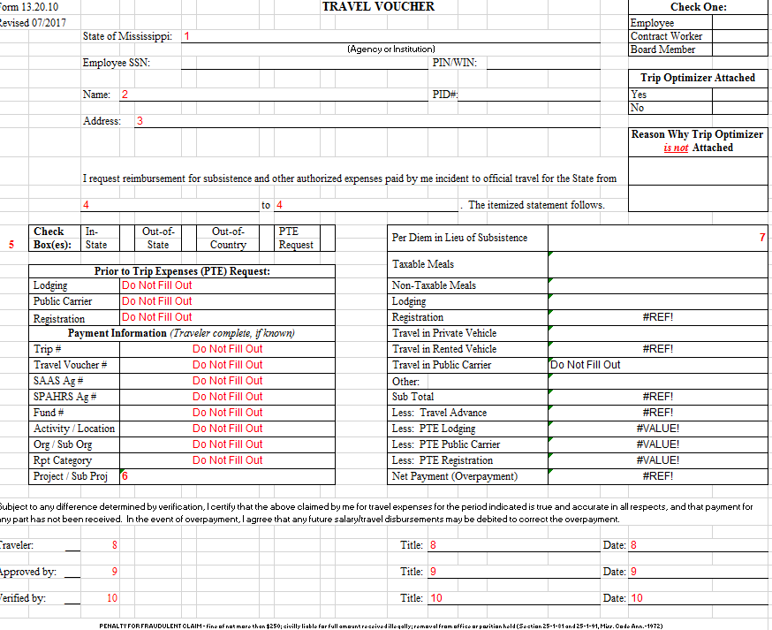
Grant Reimbursement Request Process: Travel/Training
Travel Voucher can be found on Page 36 of SGA Manual.

Slide 105
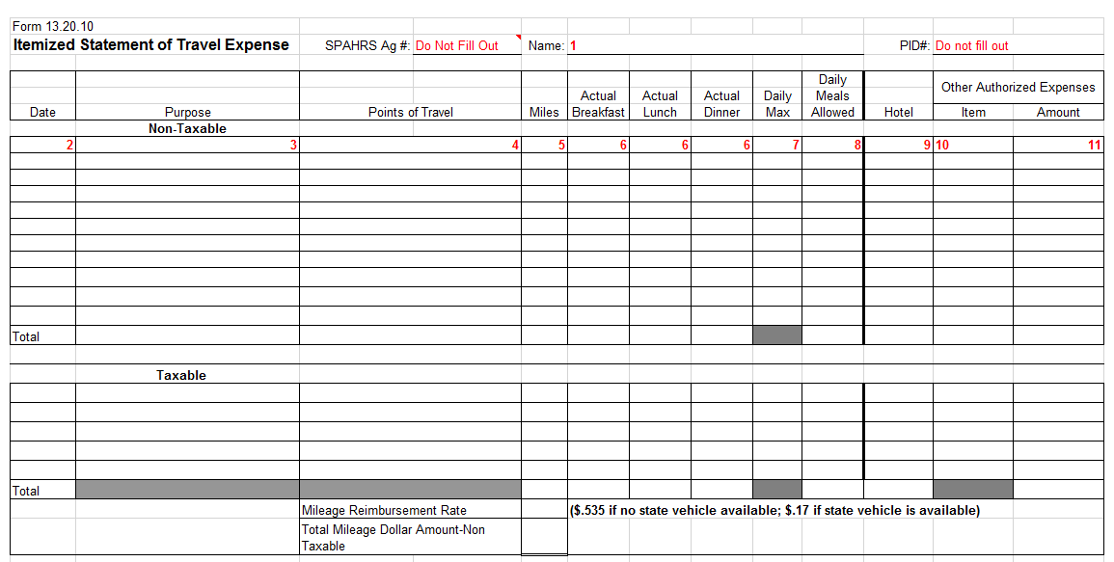
Grant Reimbursement Request Process: Travel/Training
Travel Voucher can be found on Page 36 of SGA Manual.

Slide 106
Grant Reimbursement Request Process: Travel/Training
Meal Reimbursement - Officers and employees of the state and political subdivisions shall be reimbursed the actual cost of meals incident to official travel, not to exceed the daily maximums for the specific location of assignment; except on travel days when / of the meal reimbursement is authorized.
The amount allowed for individual meals when traveling within the continental United States (including Alaska) shall be at the discretion of the governing authority or the department head, provided that the total does not exceed the maximum state reimbursement rate listed below. Meal reimbursements are not allowed within the official duty station. Alcoholic beverages are not reimbursable. Meals can only be claimed with an overnight hotel stay.
A list of the maximum state reimbursement rates for meals in high cost areas has been pre-calculated for your convenience and is available on the OPTFM Travel Information website at: https://www.dfa.ms.gov/dfa-offices/purchasing-travel-and-fleet-management/bureau-of-purchasing-and-contracting/travel/hotels-meals-miles-reimbursements/meal-reimbursement/
If you cannot find the city you are looking for, locate the county and use the amount listed. If neither the city nor county is listed, the maximum state reimbursement rate is $46.00/day. The DPS policy for meal reimbursements for all Sub-Recipients and employees of the MOHS is as follows: Travel cost must coincide with all MOHS, state, and federal guidelines/policies/rates.

Slide 107
Grant Reimbursement Request Process: Travel/Training
Meal Tips-Meal tips should be included in the actual meal expense unless the inclusion of the tips would cause the meals to exceed the maximum daily limitations placed on meals by the Department of Finance and Administration. Total meal tips shall not exceed 20% of the maximum daily meal reimbursement claimed.
Travel Receipts: All travel in-state must include itemized receipts for meal, lodging and mileage reimbursement.
Itemized receipts should be received with all meal reimbursements for in-state travel. Itemized receipts are not required for out of state travel.
To receive reimbursement for claims that include meals please remember the following:
All meal receipts must be itemized.
All meal receipts must be legible.
Itemized meal receipts should reflect only meals for (1) individual.
If purchasing a meal to consume for another mealtime later that day (and allowed under travel guidelines), purchases should be reflected on a separate itemized receipt.
The purchase of alcohol should not be included on itemized meal receipts.

Slide 108
Grant Reimbursement Request Process: Travel/Training
Mileage Reimbursement - The rate set forth per Section 25-3-41, Mississippi Code of 1972, which mandates that state officers and employees traveling on official state business in their private vehicle be reimbursed at the same rate federal employees are for official federal business in private vehicle. The current reimbursement rate is set forth in the Mileage Reimbursement Rate memo: https://www.dfa.ms.gov/media/qfplg0td/01012022-mileage-memo.pdf
The MOHS policy for mileage reimbursements for all Sub-Recipients and employees of the MOHS is as follows:
Proof of mileage should be received with all mileage reimbursement. Travel cost must coincide with all MOHS, state, and federal guidelines/policies/rates. {Ex. MapQuest} Grant approved surveyors may utilize vehicle odometer mileage readings (trip beginning and ending mileage readings).
When two or more employees travel in one private vehicle, only one travel expense at the authorized reimbursement rate per mile shall be allowed.

Slide 109
Grant Reimbursement Request Process: Travel/Training
Local/Municipal-Owned Vehicle- Actual operating expenses incurred in the use of agency-owned vehicles for grant related travel will not be reimbursed by MOHS.
Taxi Fares-Fares for taxis or airport transportation services to and from a hotel require a receipt which must be attached to the Travel Voucher to receive reimbursement for that item. The MOHS policy for transportation reimbursements for all Sub-Recipients and employees of the MOHS is as follows: Transportation reimbursements will not be reimbursed for travel to/from personal entertainment during travel. Travel is only reimbursable for approved program related travel. Travel cost must coincide with all MOHS, state, and federal guidelines/policies/rates.
Hotel/Airport Parking: Itemized Receipts must be attached to the Travel Voucher.

Slide 110
Grant Reimbursement Request Process: Travel/Training
Baggage Allowance: Charges for baggage at check-in may vary per airline. Baggage fees are reimbursable expenses according to grant agreement; however, they may not be paid for with the Travel Card. A receipt is required for charges.
Lodging - If a member(s) of the grant funded employee's family travels with the grant funded employee, the employee shall claim reimbursement at the single hotel/motel room rate only. Express check-out receipts which do not provide an itemized hotel bill are not acceptable.
Official Duty Station: The city, town, or other location where the employee's regular place of work is located, or the city, town, or location where the employee's primary work is performed on a permanent basis. If the employee regularly works in two or more areas, his official duty station shall be where the regular place of work is located. The regular place of work should be determined by the entity head or authorized designee based on total time ordinarily spent working in each area and the degree of business activity in each area.

Slide 111
Equipment (Only if Approved)

Slide 112
Sub-Recipient Grant Administrator’s Guide-Equipment
Equipment is eligible for reimbursement as a direct expense chargeable to a specific project agreement, provided the equipment is needed to perform that project. Equipment must be used, managed, and disposed of in accordance with applicable Federal requirements. All equipment must meet the requirements stated here, and all expenditures to purchase equipment are submit to audit. (See 2 CFR 200.439)

Slide 113
Equipment: Definition
*Items regardless of value must also be considered part of inventory and equipment.
Weapons
Camera and Camera Equipment (greater than or equal to $250.00)
Two-way Radio equipment
Televisions (greater than or equal to $250.00)
Lawn maintenance equipment
Cellular Phones

Slide 114
Equipment: Definition
*Items regardless of value must also be considered part of inventory and equipment.
Computers and computer equipment (greater than or equal to $250.00)
Chainsaws
Air Compressors
Welding Machines
Generators
Motorized Vehicles

Slide 115
Equipment: Definition
Per the Mississippi Office of the State Auditor, Property Officer’s Manual (2018), equipment is defined as:
They are for acquisition of visible, tangible state property.
They are non-consumable in nature.
Their anticipated life is at least one year.
If the cost of acquisition is $1,000.00 or more*, the equipment shall be on the inventory.

Slide 116
Equipment: Authorized Equipment List (AEL)
All Equipment purchased with MOHS grant funds MUST be listed on the FEMA Authorized Equipment List (AEL)
The Authorized Equipment List (AEL) is a list of approved equipment types allowed under FEMA’s preparedness grant programs. The intended audience of this tool is emergency managers, first responders, and other homeland security professionals. The list consists of 21 equipment categories divided into categories, sub-categories and then individual equipment items. NOTE: There are no commercially available products listed; it only consists of equipment types.
https://www.fema.gov/grants/guidance-tools/authorized-equipment-list

Slide 117
Equipment: Authorized Equipment List (AEL)
Unless otherwise stated, equipment must meet all mandatory statutory, regulatory, and FEMA-adopted standards to be eligible for purchase using these funds, including the Americans with Disabilities Act.
In addition, recipients will be responsible for obtaining and maintaining all necessary certifications and licenses for the requested equipment.
Per the Mississippi Department of Finance and Administration, along with the Department of Public Safety, two (2) Quotes must be received for any piece of equipment is $5,000 or more and/or state contract.

Slide 118
Equipment: Purchasing
Equipment purchased with federal grant funds is intended to be purchased and used within the grant period.
Agencies should begin procurement of equipment within the 1st Quarter of the grant. This may require receiving quotes, purchase orders, etc.
All activities toward the purchase of awarded equipment should be placed on the agency Quarterly Progress Report.

Slide 119
Equipment: Purchasing Delays and Extensions.
Due to COVID-19 and manufacturing delays, agencies may experience delays in the procurement of equipment.
Go ahead and begin procurement ASAP!!!!
If procurement is delayed and the acquirement of equipment and materials will be outside the grant award date (8/30/2023), please request an extension.

Slide 120
Equipment: Use of Equipment
Reporting Use of Equipment: Sub-Recipients are required to report the use of the equipment that has been purchased with federal funds, during the FULL use of the equipment. Equipment must be used for its intended purpose and only for GRANT Activity.

Slide 121
Equipment: Property Management Systems
All equipment purchased with federal grant funds, must be tracked through the awarded agency property management system for the life of the equipment.

Slide 122
Equipment:
Useful Life Schedule: The MOHS/Sub-Recipient property and equipment purchased in whole or in part with federal funds will be monitored for its useful life according to the following schedule. The MOHS uses several sources for the Useful Life Schedule for more information, please contact the MOHS.
Pages 8-10 of SGA Manual

Slide 123
Equipment:
Ensuring the Future is Made in All of America by All of America’s Workers: The Sub-Recipient must comply with the “Build America, Buy America” provisions of the Infrastructure Investment and Jobs Act and E.O. 14005 which provide that, as appropriate and to the extent consistent with law, the recipient must use all practicable means within their authority under a federal award to provide a preference for the purchase, acquisition, or use of goods, products, or materials produced in the United States (including but not limited to iron, aluminum, steel, cement, and other manufactured products.)
Procurement of Recovered Materials: States, political subdivisions of states, and their contractors must comply with Section 6002 of the Solid Waste Disposal Act, Pub. L. 89-272 (1965), (codified as amended by the Resource Conservation and Recovery Act, 42 U.S.C. § 6962.) The requirements of Section 6002 include procuring only items designated in guidelines of the Environmental Protection Agency (EPA) at 40 C.F.R. Part 247 that contain the highest percentage of recovered materials practicable, consistent with maintaining a satisfactory level of competition.

Slide 124
Equipment:
Ownership:
Intellectual Property (Patents/Copyright/Trademarks/Tangible Research Property (2CFR 200.315 and 200.448): The MOHS reserve a royalty-free, nonexclusive, and irrevocable license to reproduce, publish or otherwise use, and to authorize others to use, for federal and state government purposes the following:
The Intellectual Property in any work developed under a grant, sub-grant, or contract under a grant or sub-grant.
Any rights of Intellectual Property to which grantee, Sub-Recipient, or a contractor purchases ownership with grant funds.
All records, reports, documents, or other material related to this sub-grant and or obtained or prepared by Sub-Recipient in connection with performance of the services contracted for herein shall become the property of MOHS, and shall upon request, be returned by MOHS to Sub-Recipient, at Sub-Recipients expense at termination or expiration of the sub-grant.

Slide 125
Equipment:
Materials, Discoveries, Inventions and Results Developed, Produced or Discovered: All records, reports, documents, and other material delivered or transmitted to Sub-Recipient by the MOHS shall remain the property of the MOHS, and shall be returned by Sub-Recipient to MOHS at the Sub-Recipient’s expense, at termination or expiration of the sub-grant.
All records, reports, documents, or other material related to this sub-grant and or obtained or prepared by Sub-Recipient in connection with performance of the services contracted for herein shall become the property of MOHS, and shall upon request, be returned by MOHS to Sub-Recipient, at Sub-Recipients expense at termination or expiration of the sub-grant.
Use of DHS Seal, Logo, and Flags: All brochures; course, workshop, and conference announcements; and other materials that are developed and/or printed using grant funds must include a statement crediting the MOHS. The FEMA logo should not be used unless prior approval is received from the MOHS and or FEMA.
Reports, Studies, or Material Developed for Publication: Reports, studies or other materials approved for publication or printing is to be regarded as information in the public domain and its further use does not require approval. The Sub-Recipient agrees that the published versions of reports, studies or other materials shall not be copyrighted nor contain any restriction which prohibits distribution and reproduction. The Sub-Recipient will not sell copies of such reports or other materials prepared under the terms of this sub-grant.

Slide 126
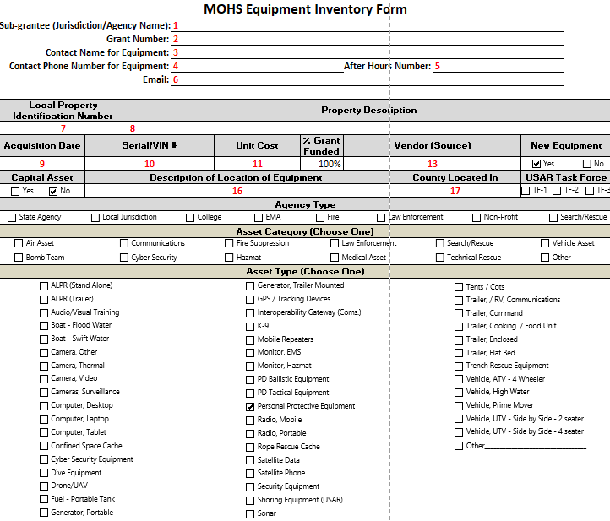
Grant Reimbursement Request Process: Equipment Form Pages 34-35 in SGA Manual

Slide 127
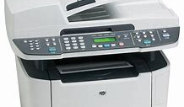
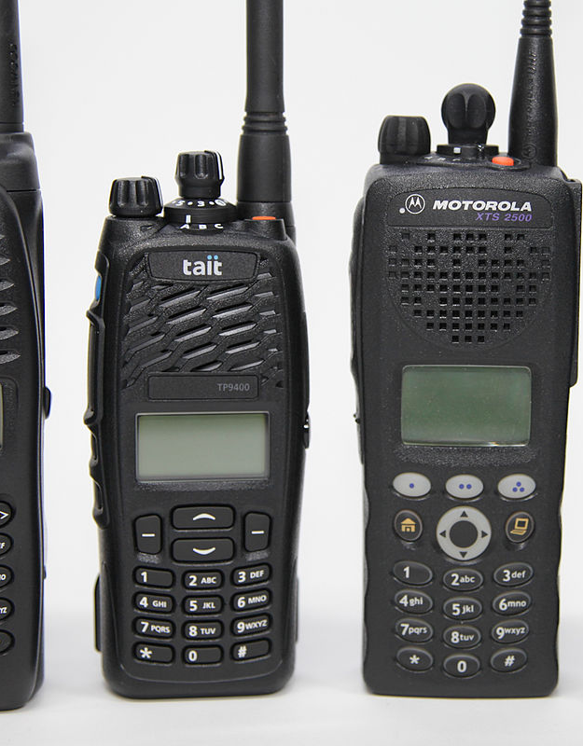
MOHS will need picture of all equipment purchased with grant funds. Please include Serial and VIN Numbers, if applicable.

Slide 128
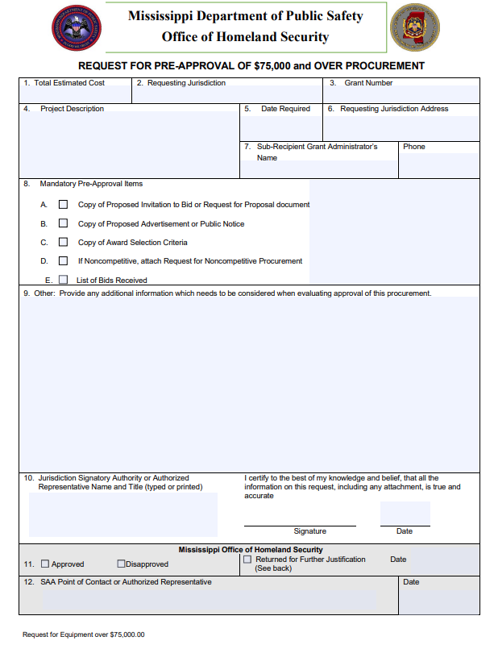
Grant Reimbursement Request Process: Additional Form (If Applicable)
Please fill out if you have items that are being purchased for $75,000.01 and above.

Slide 129
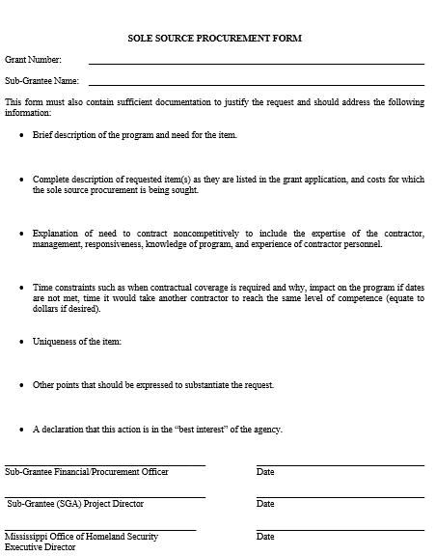
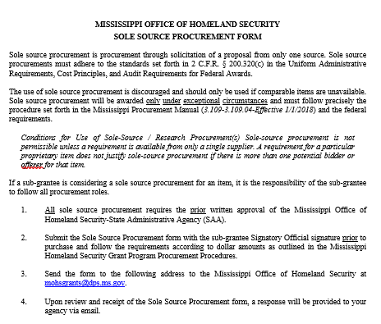
Grant Reimbursement Request Process: Additional Form (If Applicable)
SOLE SOURCE FORM
Notes:
Sole Sources forms are rare to use. Sole source is not to be used to purchase equipment from a preferred vendor, because the agency once want to purchase from a particular vendor. This should ONLY be used for specialized equipment or supplies that CAN NOT be found from any other vendor.
Example: Hydraulic Tools

Slide 130
Equipment: Disposition
If any material or equipment ceases to be used in project activities, the sub-recipient agrees to promptly notify MOHS.
In such event, MOHS may direct the sub-recipient to transfer, return, keep, or otherwise dispose of the equipment.

Slide 131
Commodities/ Supplies (Only if Approved)

Slide 132
Commodities/Supplies
Commodities:
Office Supplies--The actual cost of office supplies (pencils, pens, paper, paper clips, etc.) and training materials will be reimbursed, if applicable. Documentation must be provided for any amount claimed.
Equipment Under $1,000.00-- The actual cost of minor equipment will be reimbursed, if applicable. Documentation must be provided for any amount claimed.

Slide 133
Unallowable

Slide 134
Unallowable
Limitations and Conditions: The provisions stated in the following section are not intended to deny flexibility in supporting potential accident and injury reduction activities; however, the conditions do serve as a guide in describing costs that are not allowable for Homeland Security funding. See FEMA Homeland Security Grant Preparedness Manual.
https://www.fema.gov/grants/preparedness/homeland-security
FEMA Approval: Grant funds may not be used for the purchase of equipment not approved by DHS/FEMA. Grant funds must comply with IB 426 and may not be used for the purchase of the following equipment: firearms; ammunition; grenade launchers; bayonets; or weaponized aircraft, vessels, or vehicles of any kind with weapons installed.
If its not listed in your Grant Award, its unallowable.

Slide 135
Unallowable
Unallowable Equipment Costs:
Per FEMA policy, the purchase of weapons and weapons accessories, including ammunition, is not allowed with HSGP funds.
Small, unmanned Aircraft (SUAS) Drones.
Body worn cameras.
Maintenance Contacts: Maintenance contracts, warranties, repair or replacement costs, upgrades, and user fees are only allowable in the following circumstances:
The use of DHS/FEMA preparedness grant funds for maintenance contracts, warranties, repair or replacement costs, upgrades, and user fees are allowable, as described in FEMA Policy FP 205-402-125-1 under all active and future grant awards, unless otherwise noted. Except for maintenance plans or extended warranties purchased incidental to the original purchase of the equipment, the period covered by maintenance or warranty plan must not exceed the POP of the specific grant funds used to purchase the plan or warranty.

Slide 136
Unallowable
Unauthorized exercise-related costs include:
Reimbursement for the maintenance or wear and tear costs of general use vehicles (e.g., construction vehicles), medical supplies, and emergency response apparatus (e.g., fire trucks, ambulances).
Equipment: Equipment/ supplies that are purchased for permanent installation and/or use, beyond the scope of the conclusion of the exercise (e.g., electronic messaging sign)
In-Direct Costs: In-Direct cost are unallowable under these funds.

Slide 137
Unallowable
The following are common requests that are unallowable and/or unfunded:
Requests for equipment for routine/general use.
All SHSP equipment requested must assist recipients and subrecipients in achieving core capabilities related to preventing, preparing for, protecting against, or responding to acts of terrorism.
For more information refer to “Explain how applicants proposed project supports terrorism preparedness” the of this RFP.
Tactical law enforcement protective equipment for routine use or riot suppression. Items in this category are allowable only to supplement normal stores, to provide the surge capacity necessary for CBRNE terrorism response.
Vehicles
While certain vehicles are allowable, applications for vehicles will be reviewed on a case-by-case basis based on need, use, and justification.
General purpose vehicles (patrol cars, executive transportation, fire trucks and tactical/assault vehicles, etc.)
Reimbursement for the maintenance and/or wear and tear costs of general use vehicles, medical supplies, and emergency response apparatus.

Slide 138
Unallowable
Unallowable Sub-Granting Funds: Sub-Recipients are not authorized or allowed to sub-grant funds. Per 2 CFR. Part 225 (OMB Circular A-87) contributions or donations, including cash, property and services made by the governmental unit, regardless of recipient, are unallowable.
Unallowable Promotional Items: The cost of promotional items and memorabilia, including models, gifts and souvenirs are unallowable advertising and public relations costs. (2 CFR Part 200.421(e)(3)). Promotional items that are unallowable can include t-shirts, hats, key chains, bumper stickers, etc.
Unallowable Program Administration:
General costs of government. For States, local governments and Indian Tribes, the general costs of government are unallowable (Reference 2 CFR § 200.444 and 2 CFR § 200.474)
Entertainment costs, including amusement and social activities and expenses directly associated with such costs (such as tickets to shows or sports events, meals, lodging, rentals, transportation, and gratuities). (2 CFR § 200.438)

Slide 139
Unallowable
Supplanting: Supplanting is the act of replacing existing funds with federal funds. Specifically, funding that is established for the payment of personnel or operations required in the normal and usual conduct of business may not be replaced using federal funds awarded via the grant.
Supplanting, including: (a) replacing routine and/or existing State or local expenditures with Federal grant funds and/or (b) using Federal grant funds for costs of activities that constitute general expenses required to carry out the overall responsibilities of State, local, or Federally recognized Indian tribal governments.

Slide 140
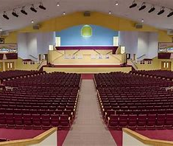
Grant Modifications

Slide 141
Modifications
During the active period of a project, changing conditions may require that the original project agreement be modified. If both parties consent to altering the project in some way, then a modification request (either activity or budget or both) must be completed. All budget modification requests must be submitted on the required MOHS forms signed and dated by the signatory authorized official.

Slide 142
Modifications-Change in SGA
Change in SGA: The Sub-Recipient agrees to notify in writing, the MOHS of any change and the reason for the request of change in personnel, no later than the submission of the next claim of reimbursement. Agency must resubmit an SGA form, if the SGA is changed from the responsibilities of grant activities.

Slide 143
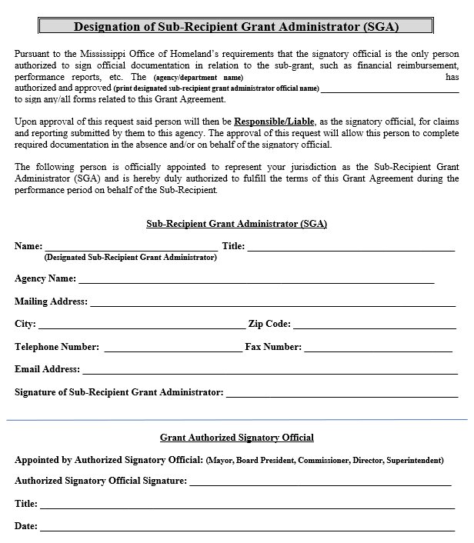
Modifications-Change in SGA

Slide 144
Modifications- Request for an Extension
Request for Extension: The Sub-Recipient may request a Request of Extension in the case of the grant activities will not be completed and/or equipment will not be received by the end of the grant performance period. Grant extensions will only be approved, if the grant follows all requirements of reporting and programmatic activities.
MUST BE RECEIVED BY: MAY31
Grants MUST be current with paperwork/reporting and have a reason for the extension.

Slide 145
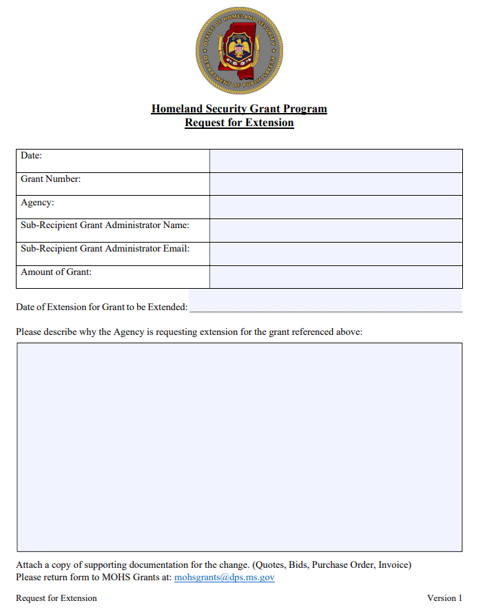
Modifications- Request for an Extension

Slide 146
Modifications- Modification of Grant
Modification Request of the Grant: Some reasons for modifying the project agreement or contract might include:
adding or deleting a performance goal
increasing or decreasing the budgeted amount
adding, deleting, or changing equipment or the Scope of the Project
Modifications are also executed to authorize a material change in other terms and conditions.
NOTE: Requests for modifications should be submitted for approval before the revision is implemented.

Slide 147
Modifications- Modification of Grant
With Non-Profit Grants, any changes to the grant will require FEMA approval.
Please speak with your Program Manager before you make any changes to the project.
The MOHS will work with you on the modification and what will be needed for the changes.

Slide 148
Modifications- Modification of Grant
The Sub-Recipient must submit the modification to the MOHS email address of mohsgrant@dps.ms.gov. Effective date will not be issued until both parties have executed the modification.
When an amendment is needed, sufficient time should be allowed for proper review and execution. With sufficient advance planning and ongoing monitoring, Sub-Recipients should have any amendments to a grant or Contract executed 90 days prior to the end of the grant or by May 31.
When a simple budget modification is needed, sufficient time (a minimum of two weeks) should be allowed for proper review and execution. Modifications must be signed by the parties who signed the original project agreement unless approval authority has been specifically retained or delegated to someone else in accordance with MOHS policy.

Slide 149
Modifications- Modification of Grant
Modification Processing: A modification will follow the same approval processing procedures as the original agreement. The same signature authority that applies for the original agreement also applies for any modification to that agreement.
As with the original project agreement, the modification becomes effective only when all signatures have been obtained. Sub-Recipient is allowed two (2) modifications per year and if any modifications are submitted for processing, then the last modification (#2) should be processed through the MOHS office no later than June 30st. If any modifications are sent to be processed, the modification must be approved by the MOHS.
NOTE: MOHS Sub-Recipients are allowed (2) two budget modifications during the grant year. Budget Modifications will not be accepted until the 2nd quarter, unless approved by the MOHS Grants Director.

Slide 150
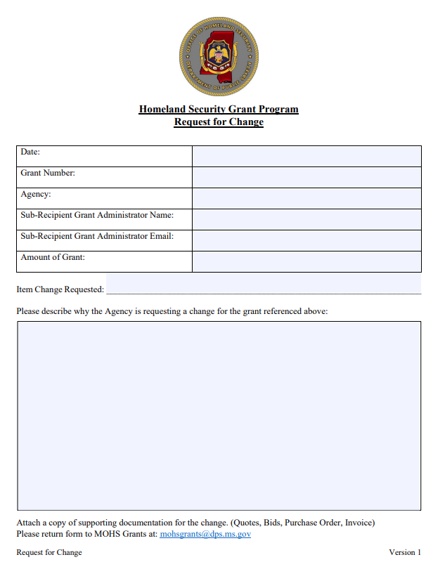
Modifications- Modification of Grant Request for Change.

Slide 151
Modifications- Modification of Grant
All Modifications to Non-Profits will submitted to FEMA as an Amendment. Amendments are a formal process, which FEMA will review the change, reasons for the change and provided documentation.
If the Amendment is approved, then FEMA will send an Approval Notice and the Notice will be forwarded to you.
After the Amendment, has been approved, then the MOHS will work with you on the paperwork needed for the revision to the grant.

Slide 152
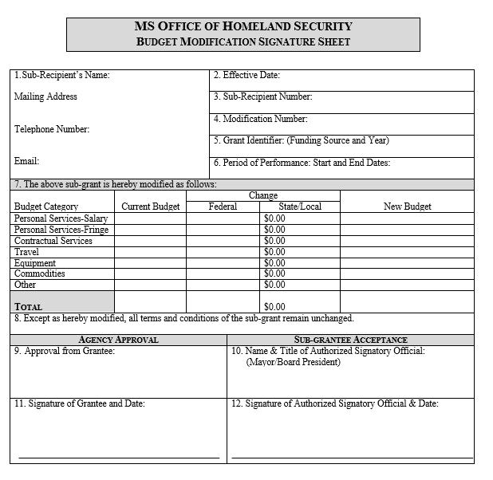
Modifications- Modification of Grant Request for Change

Slide 153
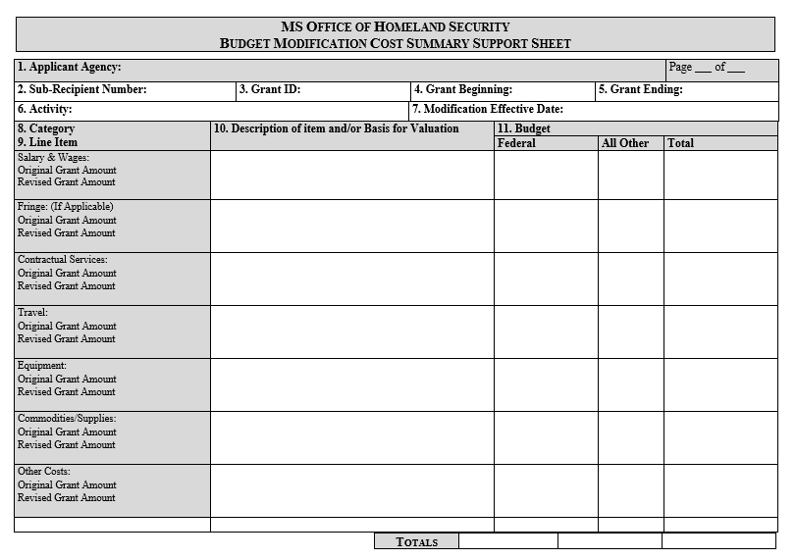
Modifications- Modification of Grant Request for Change

Slide 154
Let’s Take a Break
10 Minutes

Slide 155
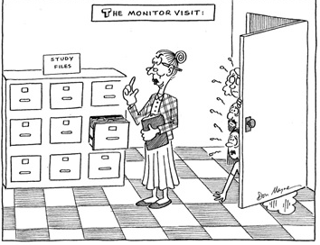
FY22 Homeland Security Grant Program
Monitoring Visits
Step 5:

Slide 156
Monitoring Visits: Why Do We Monitor?
MOHS is required to monitor, by federal guidelines.
To confirm the funds were used for the purpose stated in the grant request.
Assist with compliance observations for future visits.
Ensure that State and Federal programs are programmatically and financially compliant to State and Federal Guidelines and are in line with the approved grant contract.
Detect and identify concerns from the sub-recipients or the contracts.
Assure targets and performance measures are being met and achieved.

Slide 157
Monitoring Visits: Benefits of Monitoring
Develops and builds relationships
Proactively educates sub-recipient
Identifies any problems or questions
Prevents fund waste, fraud, or misuse
Improves communication processes
Gives opportunities for improvements
Ensures equipment inventory is in good working condition and maintenance records are current

Slide 158
Monitoring Visits: Benefits of Monitoring
Project Monitoring Policy: It is the responsibility of MOHS to maintain oversight for all federally funded grants that are awarded to their sub-recipients. MOHS will provide technical assistance as needed to assist the sub-recipient with fulfilling their project targets and performance measures. MOHS will ensure that the contract provisions are in compliance. (2CFR 200.328)
Depending on the monitoring criteria and policy as stated above, each grant will be reviewed either by on-site monitoring, desk reviews, via telephone calls, reimbursement processing, staff meetings, conference calls, and other correspondence, as appropriate.
Corrective Action Plan (CAP): If a corrective action plan is warranted after a monitoring visit, MOHS staff should note possible necessary solutions to the problems with an addendum to the monitoring report. MOHS staff will supply a copy of the monitoring report and the CAP to the agency for their files.

Slide 159
Monitoring Visits: Sub-Grantee Record Keeping Guide
Signed Award Letter and Grant Application
Agreement
Financial and Quarterly Reports
Reimbursement Documents
Equipment Inventory Form(s) and Photos
EHP Forms

Slide 160
Monitoring Visits: What to Expect?
Pre-Monitoring Notification Letter/Email
30 days prior to monitoring visit
Notification of date and time
What grant(s) is being monitored (can be multiple grant years)
What documentation is needed for review
What equipment is needed for inspection/photos
Name of person to complete the monitor visit and contact information
You will receive a confirmation call 3-5 days prior to the scheduled visit.

Slide 161
Monitoring Visits: Types of Monitoring
Monitoring is formal and informal, financial and operational. MOHS will utilize the following types of monitoring:
Ongoing monitoring/contact with the sub-recipient through phone calls, meetings, and written/verbal correspondence;
On-site monitoring reviews of project operations, management, and financial systems;
Review and approval of reimbursement claims;
Desk monitoring of grant files; and/or
Compliance monitoring of statewide security activities and grant oversight.

Slide 162
Monitoring Visits: Types of Monitoring-Ongoing
Ongoing monitoring occurs every time a MOHS staff holds a discussion or communicates with a sub-recipient project director.
Ongoing monitoring can occur daily, weekly, or monthly. Weekly phone calls may be appropriate, if there are concerns. More regularly scheduled meetings may be needed for complex projects.
If concerns are identified, the project could require quarterly review meetings between the sub-recipient and MOHS staff. This is left at the discretion of MOHS staff and any additional monitoring requirements will be documented in the official file. MOHS staff will rely on regular correspondence and the annual monitoring to handle routine project issues.

Slide 163
Monitoring Visits: Types of Monitoring-On-Site
On-Site Monitoring will include:
Entry Meeting to answer questions and provide an overview of the monitoring process.
Review of Program Files
General Financial Documents
Grant Specific Financial Documents
Program Related Source Documents
Inspection of Equipment
Exit Meeting to report any findings and explanation of additional information needed.

Slide 164
Monitoring Visits: Types of Monitoring-On-Site
On-Site Monitoring will include:
Inspection of Equipment. Please have all grant funded equipment available for viewing.
During on-site monitoring equipment will be photographed with the serial and identification numbers.

Slide 165
Single Audit Requirements
The State of Mississippi requires a sub-recipient expending $750,000.00 or more in federal funds in the organization’s fiscal year to conduct an organization-wide audit in accordance with 2CFR200, Sub-Part F (previously OMB Circular A-133).
The sub-recipient will permit the State of Mississippi project officials, program officials and auditors to have access to the sub-recipient’s and third party contractor’s records and financial statements as necessary for the State of Mississippi to comply with the 2CFR200, Sub-Part F.

Slide 166
Single Audit Requirements
Audit Findings
Sub-Recipient should develop and issue corrective actions for findings within six months after receipt of the sub-recipient’s audit report and ensure that the sub-recipient takes appropriate and timely corrective action. Reference 2CFR 200.516

Slide 167
Record Keeping
Grant financial, programmatic, and administrative records shall be maintained for a period of three years following the date of the closure of the grant award, or audit if required. Property and equipment records shall be maintained for a period of three (3) years following the final disposition replacement or transfer of property and equipment. Reference 2CFR 200.333

Slide 168
Record Keeping
Sub-Recipients are expected to keep records of different federal fiscal periods separately identified and maintained so that information can be readily located. sub-recipients are also obligated to protect records adequately against fire and damage.
Access to sub-recipient records must include MOHS, FEMA granting agency, Office of the Inspector General, or any of agency requesting records, who shall have the right to access to any pertinent books, documents, papers or other records of the sub-recipient, which are pertinent to the award, in order to make audits, examinations, excerpts and transcripts. The right to access must not be limited to the required retention period but shall last as long as the records are retained. Reference 2CFR 200.336

Slide 169
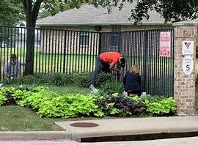
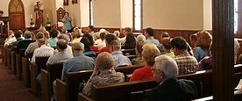
Grant Compliance and Non-Compliance

Slide 170
Non-Compliance
MOHS considered non-compliance for the following concerns:
Award Paperwork- Not Submitted on Time
Quarterly Reimbursement Claim and Progress Report –Not Submitted on Time
EHP’s Not Submitted. EHP’s not Approved and work has started.
Inventory/Equipment Forms-Not Submitted with Reimbursement.
No Pictures submitted

Slide 171
Non-Compliance
Special conditions may be imposed, reimbursements may be partially or wholly withheld, the award may be wholly or partly suspended or terminated, or future awards, reimbursements and award modification maybe withheld. Reference 2CFR 200.338
MOHS shall notify the sub-recipient of its decisions in writing stating the nature and reason for imposing the conditions, the corrective action required and timeline to remove the conditions and the method of requesting a reconsideration of the imposed conditions.

Slide 172
Non-Compliance
The sub-recipient must respond within five (5) days of receipt of notification of the reasons listed below.
Unwillingness or inability to attain project goals, performance measures or strategies;
Unwillingness or inability to adhere to the conditions of the grant agreement;
Failure or inability to adhere to grant guidelines and federal compliance requirements;
Improper procedures regarding agreements, contracts, and procurements;
Inability to submit reliable, documented and/or timely reports; and
Management systems do not meet State or federal required management standards.

Slide 173
Non-Compliance-Changes to Agreement
Sub-recipient failure to meet all reporting, attendance at meeting(s), scheduled events and timely submission of reimbursement requests set forth in the agreement by MS Office of Homeland Security, may result in the withholding of reimbursement payments. Reference 2CFR 200.339 and 2CFR 200.340

Slide 174
Termination of Agreement
The sub-recipient may terminate its participation in this agreement by notifying and submitting the required closeout documentation to the MS Office of Homeland Security, thirty (30) days in advance of the termination date.

Slide 175
Equipment: Disposition
For any equipment that needs disposition, please use the following steps:
The agency must send a letter on agency letterhead requesting to sell or dispose of equipment purchased with grant funds.
Include in the letter the type of equipment, identification/serial numbers, grant funds used to purchase equipment and the reason that equipment is being sold or disposed.
MOHS will review the request and provide a letter providing non-approval or an approval outlining the steps and actions that will need to take place.

Slide 176
FY22 Homeland Security Grant Program
STEP 6:
Closeout and End of Grant

Slide 177
Closeout and End of Grant:
All grant funded equipment should be purchased, as well as grant funded activities, should take place during the grant award dates of:
9/1/2022-8/31/2023
If the agency needs additional time to meet grant activity requirements and/or receive grant awarded equipment, please submit a Request for Extension.

Slide 178
Closeout and End of Grant:
Grant Closeout is due to MOHS (45) forty-five days after the end of the Grant Award Year.
Grant Closeout should include the following:
All reimbursement requests, along with supporting documentation.
Closeout Form

Slide 179
Closeout and End of Grant: Extensions
A Request for Extension should be sent on agency letterhead, provide a description of the delay and anticipated receiving date of the equipment and/or materials.
All request will be reviewed and provided a response for approval or non-approval of the purchase.

Slide 180
Closeout and End of Grant: Extension
If a Request for Extension is not received within the forty-five (45) prior to the grant end. The grant will be closed out on the grant award end date and any remaining funds may be re-allocated to other projects.

Slide 181
Closeout and End of Grant: Extension

Slide 182
Closeout Form

Slide 183
Closeout Form

Slide 184
Closeout Form
MOHS Staff will fill this section of the Closeout form.

Slide 185
FY22 Homeland Security Grant Program
Upcoming MOHS Grant Opportunities
Notes:
Last but not least. We do have some upcoming grant opportunities.

Slide 186
HSGP Grant Funds FY23
All Information on MOHS Website: Grants>Grant Forms
https://www.homelandsecurity.ms.gov/grants/grant-forms
Notice of Funding Releases: February 2023
Application Releases: March 2023
Grant Writing: March 2023
Application Deadline: April 2023
Notification of Award: July 2023
Grant Orientation: August 2023
Grant Period: September 1, 2023-August 31, 2024*
*Extensions may be available.
Notes:
We will be offering a Reallocation grant starting 9/15/2022.
If you are needing something and were not approved for it or maybe something has changed and you need something now. Here is your opportunity.

Slide 187
MOHS Grants :
Send All Reports, Reimbursement and Documents to:
mohsgrants@dps.ms.gov

Slide 188
MOHS Grants Staff Contacts:
Beth Loflin, Grants/Finance Director
Email Address: beth.loflin@dps.ms.gov
Catrina Stamps (Non-Profit Sub-Recipients)
Email Address: cstamps@dps.ms.gov
Phone Number: (601)987-1247
Rachel Day (North Sub-Recipients)
Email Address: rday@dps.ms.gov
Phone Number: (601)987-1248
Kayla Stewart (Central/South Sub-Recipients)
Email Address: ksstewart@dps.ms.gov
Phone Number: (601)987-1217

Slide 189
Questions

Slide 190
Grant Awards and Documents
On your way out, please drop off your Evaluation Form.

